Slide 1

Being Positive about
Going Negative
Bill Spence
(Independent)
A special thanks to the UK Committee on Climate Change for the majority of the technical content in this presentation

Slide 2
Greenhouse Gas Removal (GGR) Overview
2
GGR – Why do we need it
Nature has done this safely before
How much removal and at what cost
Conclusions

Slide 3
Why do we need removals?
2
GGR – Why do we need it?
3
We are on the verge of filling our atmosphere with more CO₂ than is safe for mankind
In the next 30 years we need to slow the release of CO₂ and launch a concerted effort of Greenhouse Gas Removal (GGR) to result in Net Zero Emissions

Slide 4








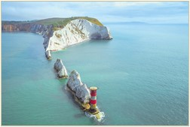
4
Nature has done this safely before
Dinosaurs lived with CO₂ levels 5 X higher than today
Nature removed CO₂ from the atmosphere …
But we have to do it a million times faster
To grow plants
which made
soil & peat
coal, oil & gas
To create rocks

Slide 5
5
Copying nature with scale & speed
Tree-Based
50-100 MtCO₂
Per year
Rock-Based
~10 MtCO₂
Per year
1-5 MtCO₂
Per year
~1 MtCO₂
Per year
BECCS
(Bioenergy+ CCS)
Forests, soil, using wood in Construction
Direct Air Capture
Enhanced Weathering

Slide 6



6
How Much GGR is Required?
Best Case
GGR Cost
>£10Bln p.a.
1/3 of total net zero budget
50MtCO₂ per year
If GGR is only required to ‘clean-up’ difficult emissions

Slide 7
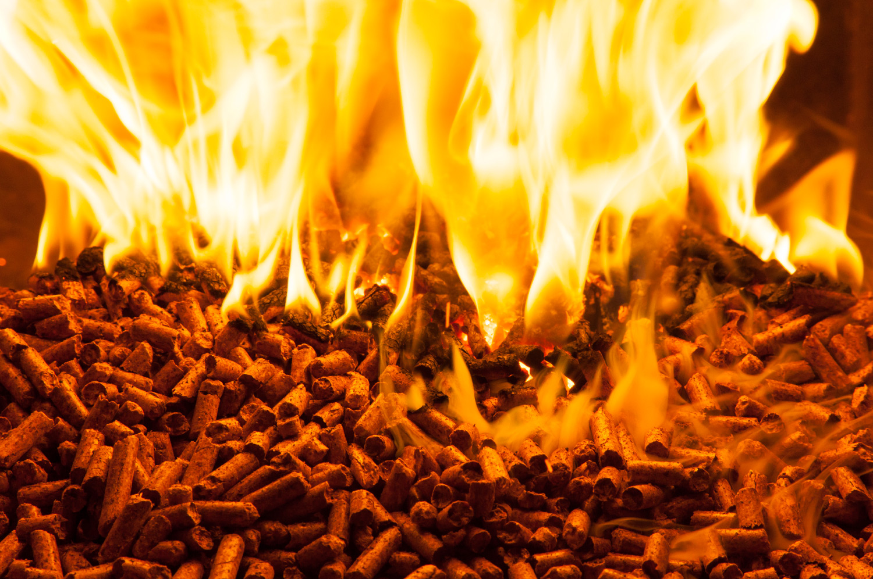
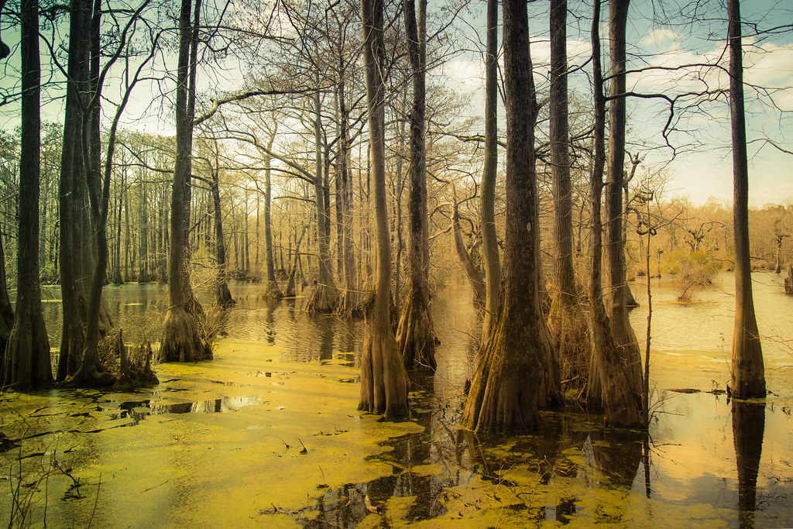
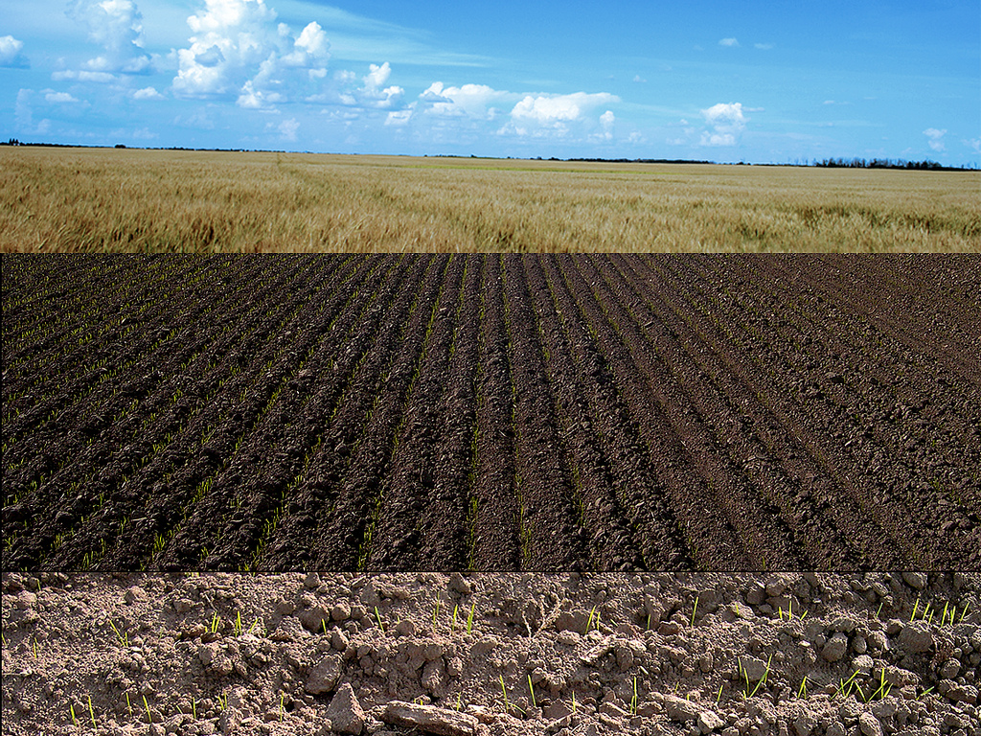
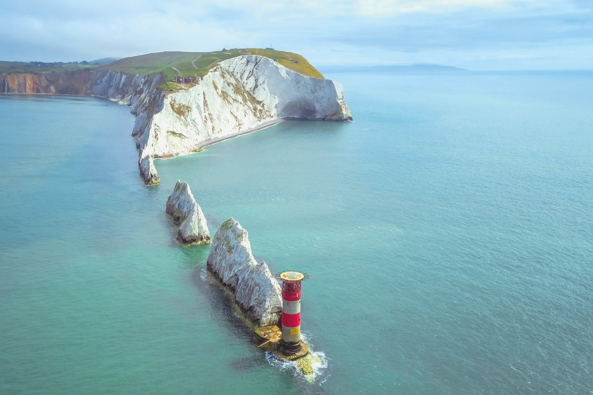
7
How Much GGR is Required?
75%
BECCS
25%
Forests, soil, using wood in construction
Direct air capture and carbon storage
Enhanced Weathering

Slide 8






8
How Much GGR is Required?
Maximum Case
Pushing limits of CCS & Bio availability
90MtCO₂
per year
If GGR is required to cover shortfalls in many sectors

Slide 9
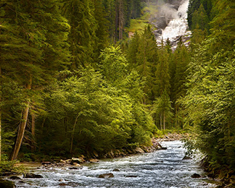
Don’t damage the forests & wetlands
to fix the atmosphere
9
Forests & Wetlands provide;
Clean air
Habitats
Livelihoods
Soil stability
Medicines
Sustainability must be core to Greenhouse Gas Removal
WARNING

Slide 10


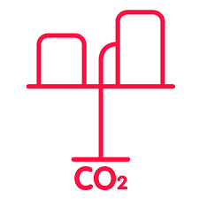
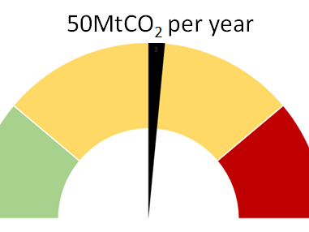


10
GGR – Summary
Get CCS Done
There is too much CO₂ in the atmosphere. We must slow emissions and start removals
Continue to develop a broad range of GGR solutions
Secure fair (international) deals to ensure a long term access to sustainable forests, plants and wetlands
Launch & grow an extensive carbon capture and storage network
We need to start today if we are to reach net zero in 2050

Slide 11
11

