Slide 1
Introduction to Climate Change
Joanna D. Haigh

Slide 2
What is Climate?
The average weather conditions in an area.
e.g. 30-year averages of temperature, humidity, rainfall, cloudiness, pressure, wind in Birmingham area.
Also variability in those conditions.
e.g. frequency of exceeding specific extreme values.
What is Climate Change?
A long-term shift in those conditions.

Slide 3
How do we know if/when climate has changed?
Records are carefully compiled from many sources including:
Satellite measurements since 1970s.
Instrumental measurements from across the globe since about 1850.
Indicators in tree rings, corals, stalagmites and stalactites over thousands of years.
Trapped air in polar ice cores over hundreds of thousands of years.
Records in ocean sediments over millions of years.

Slide 4
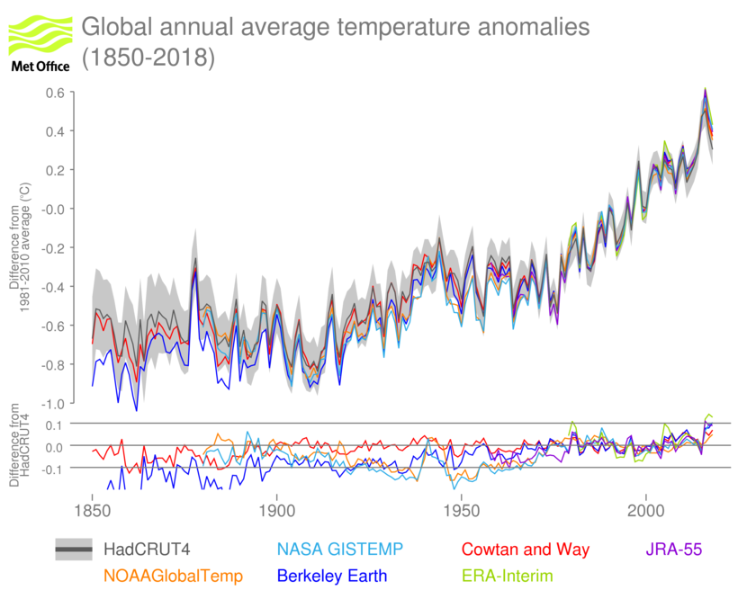
Global average temperature measurements
__
__
1 °C warmer
Average value during 1800s

Slide 5
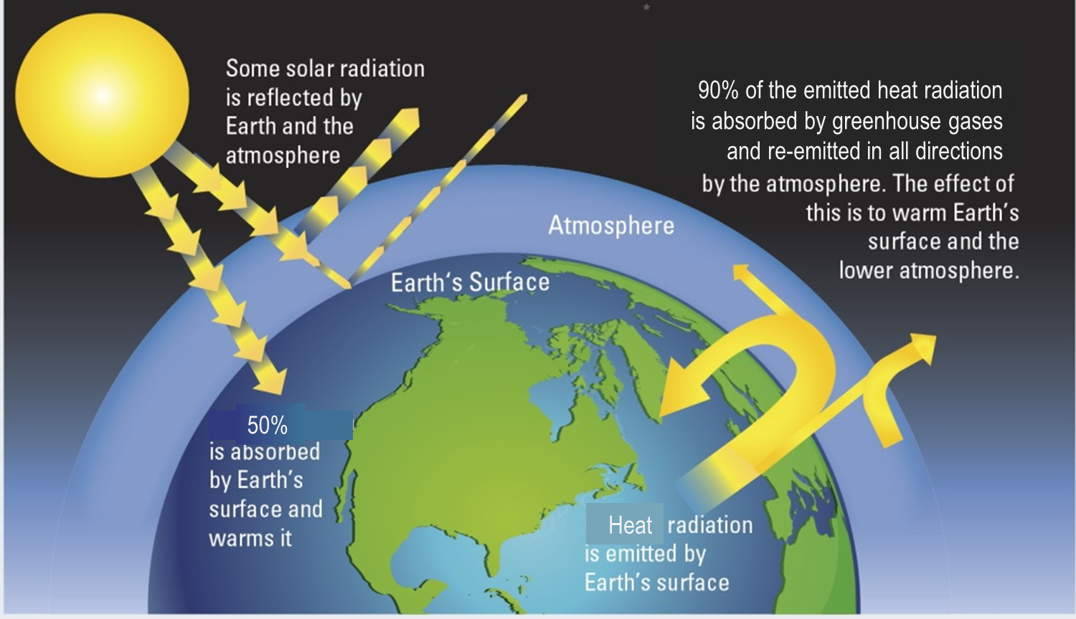
The Greenhouse Effect
Important for our natural
climate, making the surface about 30°C warmer than it would be were there no atmosphere.

Slide 6
Factors which force climate to change
Natural:
volcanic eruptions
solar radiation
Humans:
greenhouse gas emissions
industrial pollution
agriculture and land use
Responses which can reduce or enhance the initial warming (or cooling)
changes in humidity, clouds and ice
heat storage by oceans
natural variations & “noise”

Slide 7
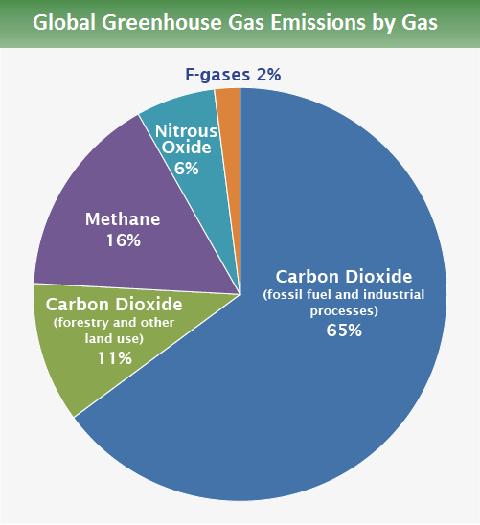
Greenhouse gas (GHG) global emissions due to human activity
IPCC (2014)
Notes:
Methane
Emitted naturally by wetlands, termites, oceans & ice; destroyed in the atmosphere and by soils.
Human activities – rice paddies, ruminant animals, waste treatment – have doubled its atmospheric concentration since 1900.
Nitrous oxide
Emitted naturally by uncultivated soils and oceans; destroyed in the atmosphere
Human activities – use of fertilisers, combustion of fossil and biofuels – have increased its atmospheric concentration by 20%.
F-gases
No natural sources.
Developed to replace gases destroying the ozone layer.

Slide 8
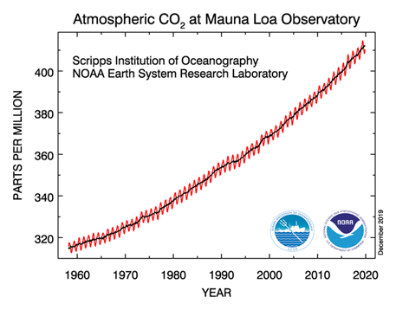
Atmospheric carbon dioxide concentration
measured on Hawaii

Slide 9
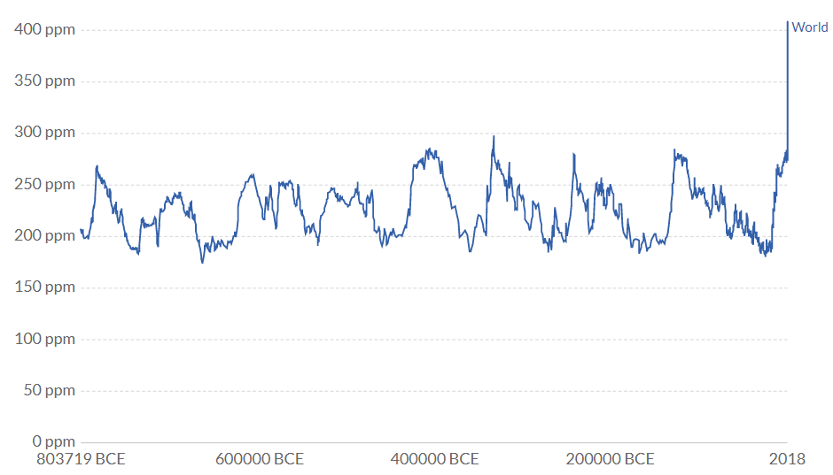
Atmospheric carbon dioxide concentration over the past 800,000 years
Hawaii
measurements
Ice core
measurements

Slide 10
Carbon dioxide (CO₂)
CO₂ - naturally transferred between plants, soils, atmosphere, oceans & ice balancing at an atmospheric concentration of about 280 ppm.
Now more than 400 ppm - higher than for over 3 million years.
The increase is due to human combustion of fossil fuels.
CO₂ remains in the atmosphere for about 200 years so emissions are accumulating.

Slide 11
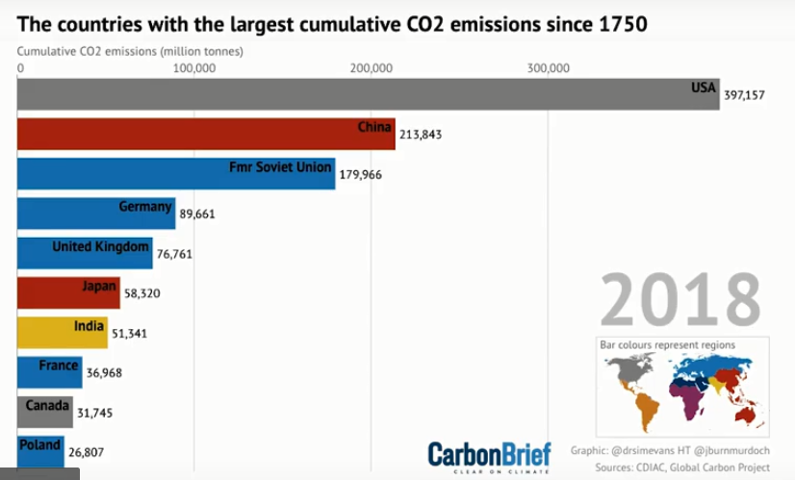
Greenhouse gases accumulation
Notes:
global challenge

Slide 12
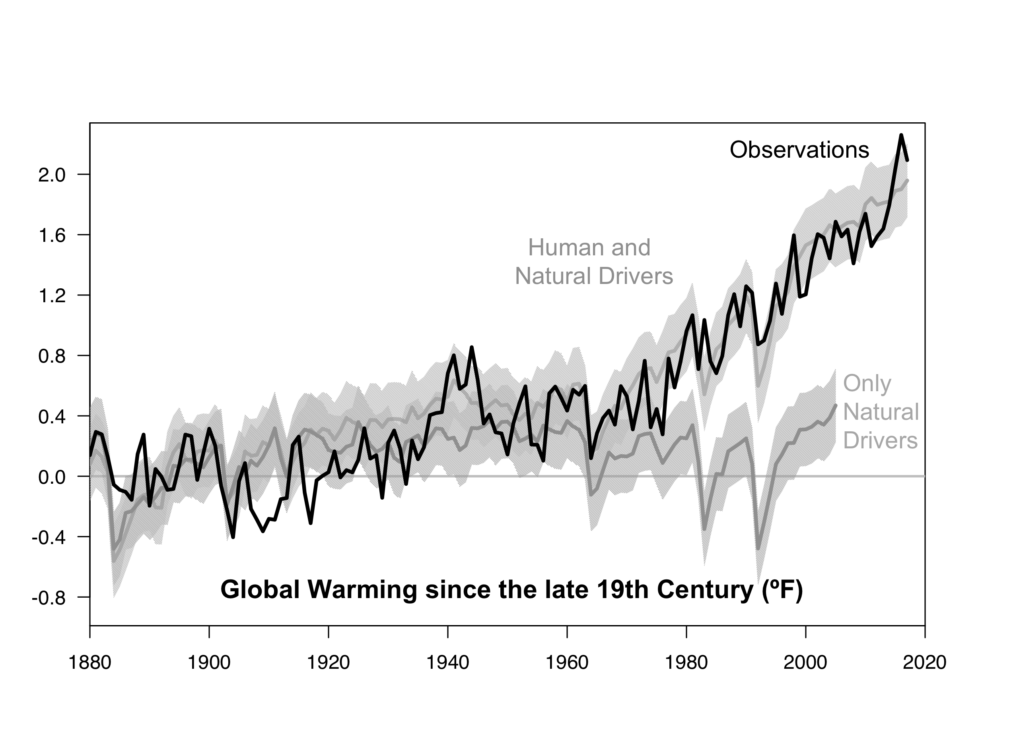
Natural and human impacts on global temperature
°C
1.0 -
0.5 -
0.0 -
-0.5 -
Black: observations
Grey: computer model calculations with and without human drivers
Notes:
note range given by shading

Slide 13
Greenhouse gases and global warming
The global temperature rise is directly related to the accumulated emissions of GHGs.
To stop the temperature rising above any specific threshold means a limit to total GHG emissions.
This amount is called the Carbon Budget.
If the carbon budget is used up then any further emissions must be balanced by removing CO₂ from the atmosphere at the same rate as it is put in: “Net Zero Emissions”.
To keep warming below 1.5°C above pre-industrial means reducing emissions to net zero by about 2050.
Notes:
global challenge

