Slide 1


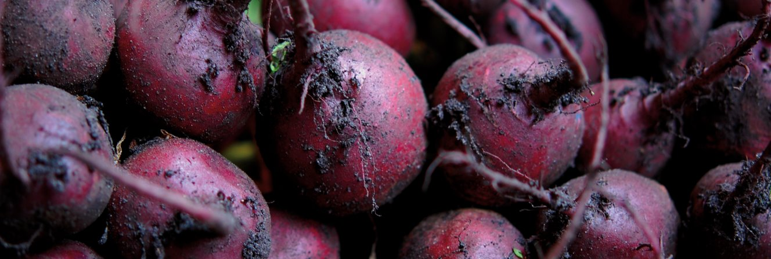
Our Future in the Land
Radical and practical change for food, farming and the countryside

Slide 2
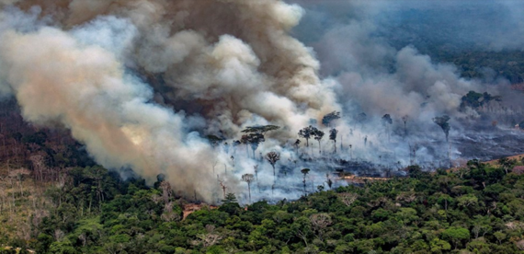
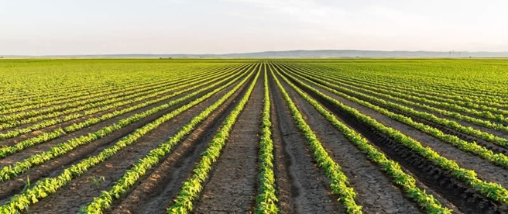
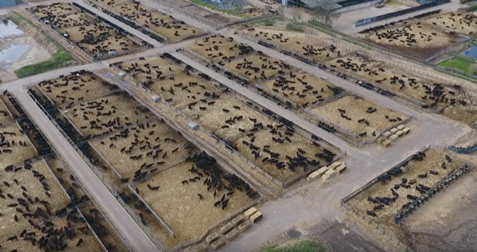
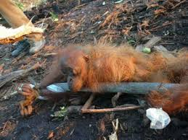


“a small number of commodities, grown as cheaply as possible, in ‘outdoor factories’, for global markets”

Slide 3
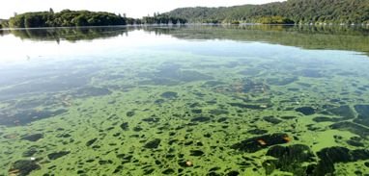
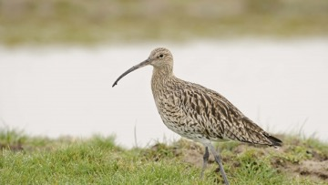
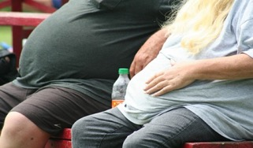
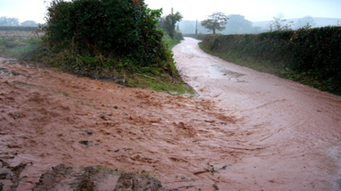

This has consequences

Slide 4
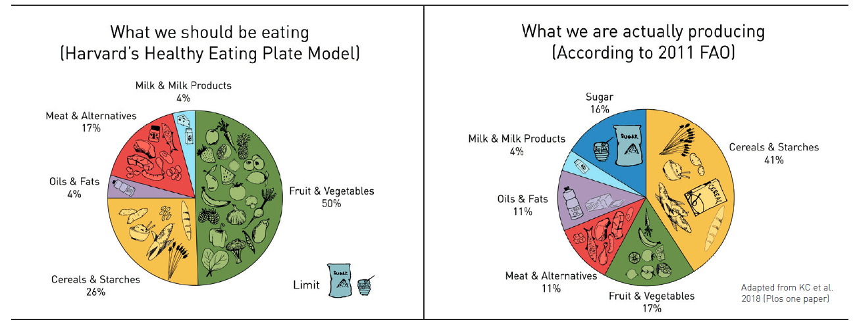
What we should eat What we produce

Slide 5
The UK’s “cheap” food policy
The 3rd cheapest ‘basket of food’ amongst all the developed countries in the world
BUT
2.2 million people in the UK suffer ‘food poverty” - the worst in Europe
AND
Type 2 diabetes costs £12bn to the NHS and £15bn in working days lost
The cost of removing drug residues from the water supply is (currently) incalculable

Slide 6
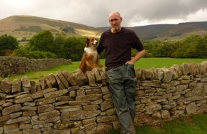
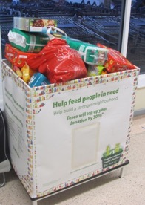
SO WHERE’S THE MONEY…?
Over 2000 food banks around the UK
“I’m a farmer and I can’t afford to buy the food I produce”

Slide 7
Global agribusiness is worth £2.4 trillion
Four companies control global 65% seed production
Four companies control global 70% agrichemicals business
Four retailers control 68% of UK food market - Tesco, Asda, Sainsbury, Morrisons
And in terms of the food you eat….
Notes:
Squeezes farmer incomes
Reduces farmer’s control
Limits innovation
Waters down social responsibility
Risks to environment & health
Controls information
Increases labour abuses
Shapes countries’ policies

Slide 8
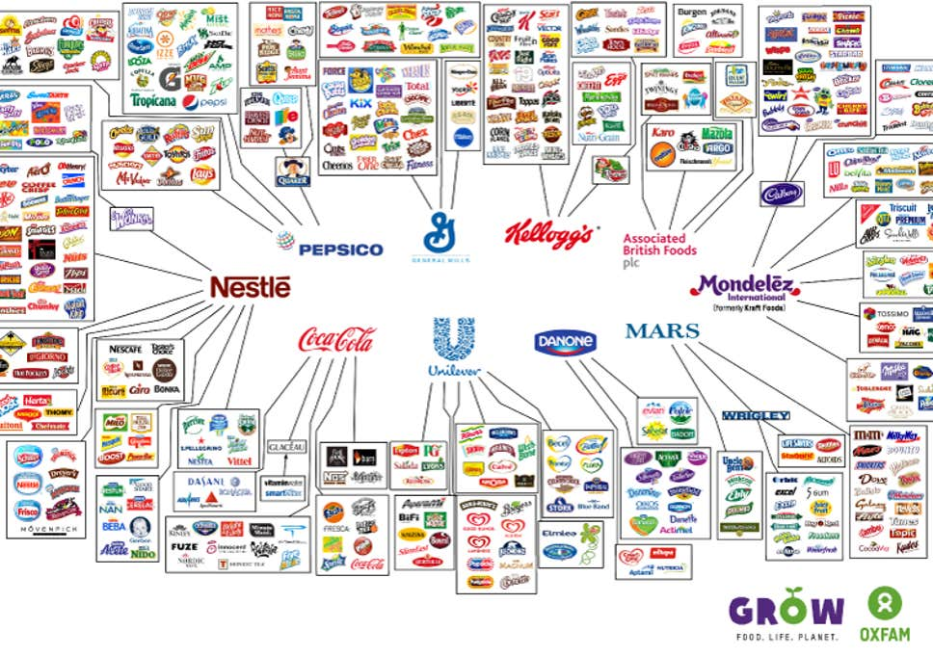

Slide 9
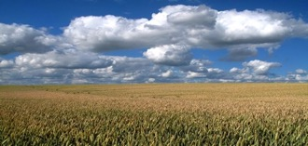
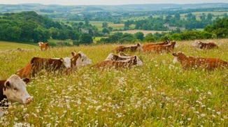
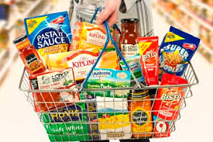
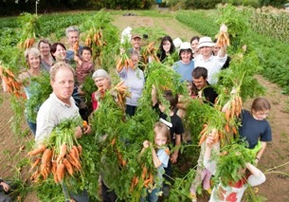
What’s the future we want?
Intensive land use, high demand
Extensive land use, low demand

Slide 10
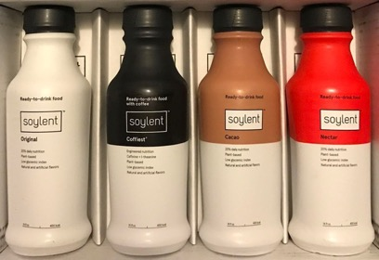
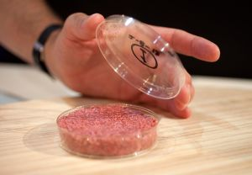
Or… hyper processed food grown in labs or in your own home

Slide 11
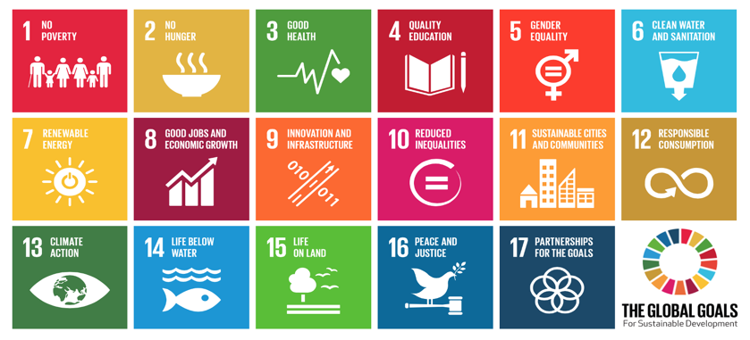
It’s all connected…

Slide 12

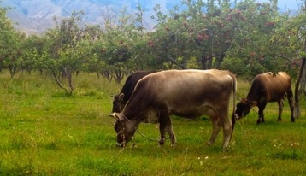
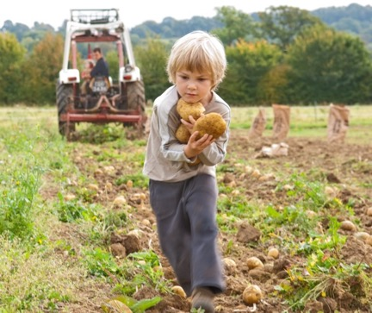
Agroecology
A comprehensive approach to food and farming, in harmony with nature, better for the climate, our health and wellbeing, sustainable and fair for everyone on the planet

Slide 13
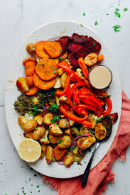

Healthy food is every body’s business
1. Level the playing field with
radical restrictions on producing and marketing unhealthy foods
designing healthier high streets
international measures to stop concentrations of power and control
2. Government and councils use their buying power for healthy sustainable UK food in schools, hospitals, prisons
3. Use more fruit, veg, nuts and pulses in everyday foods

Slide 14
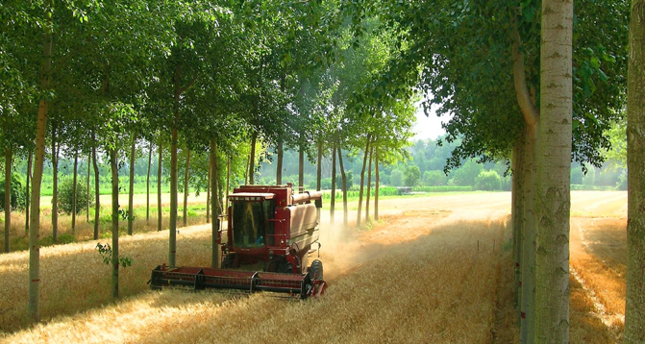
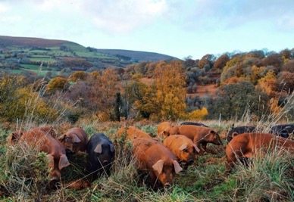

Slide 15
Farming can be a force for change
A ten-year plan for agro-ecology by 2030
plant trees, restore peatlands, manage wetlands and waterways, restore grassland, grow hedges and habitat corridors, reduce anti-biotics chemicals, improve animal welfare, fair prices
Support ethical innovations - eg small robots and precision agriculture
Tax & regulate pollution
Set budgets for carbon & minerals use
Invest in UK horticulture – more fruit, vegetables, nuts, pulses, “less & better” meat & dairy from sustainable agriculture
Indoor urban farming uses much less water, less energy, less transport
BUT not all crops work; and health impacts unclear

Slide 16
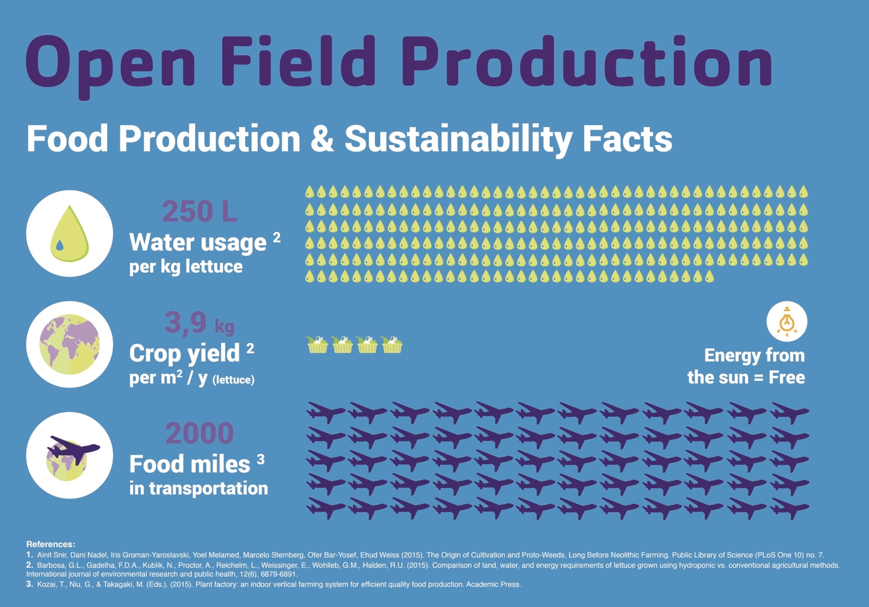

Slide 17
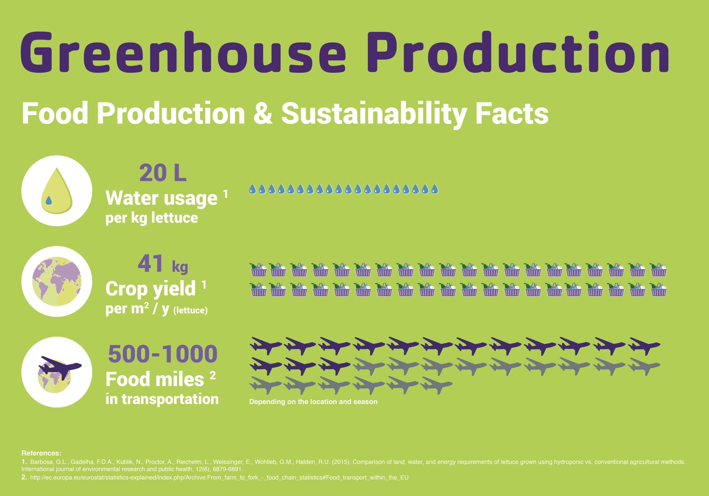

Slide 18
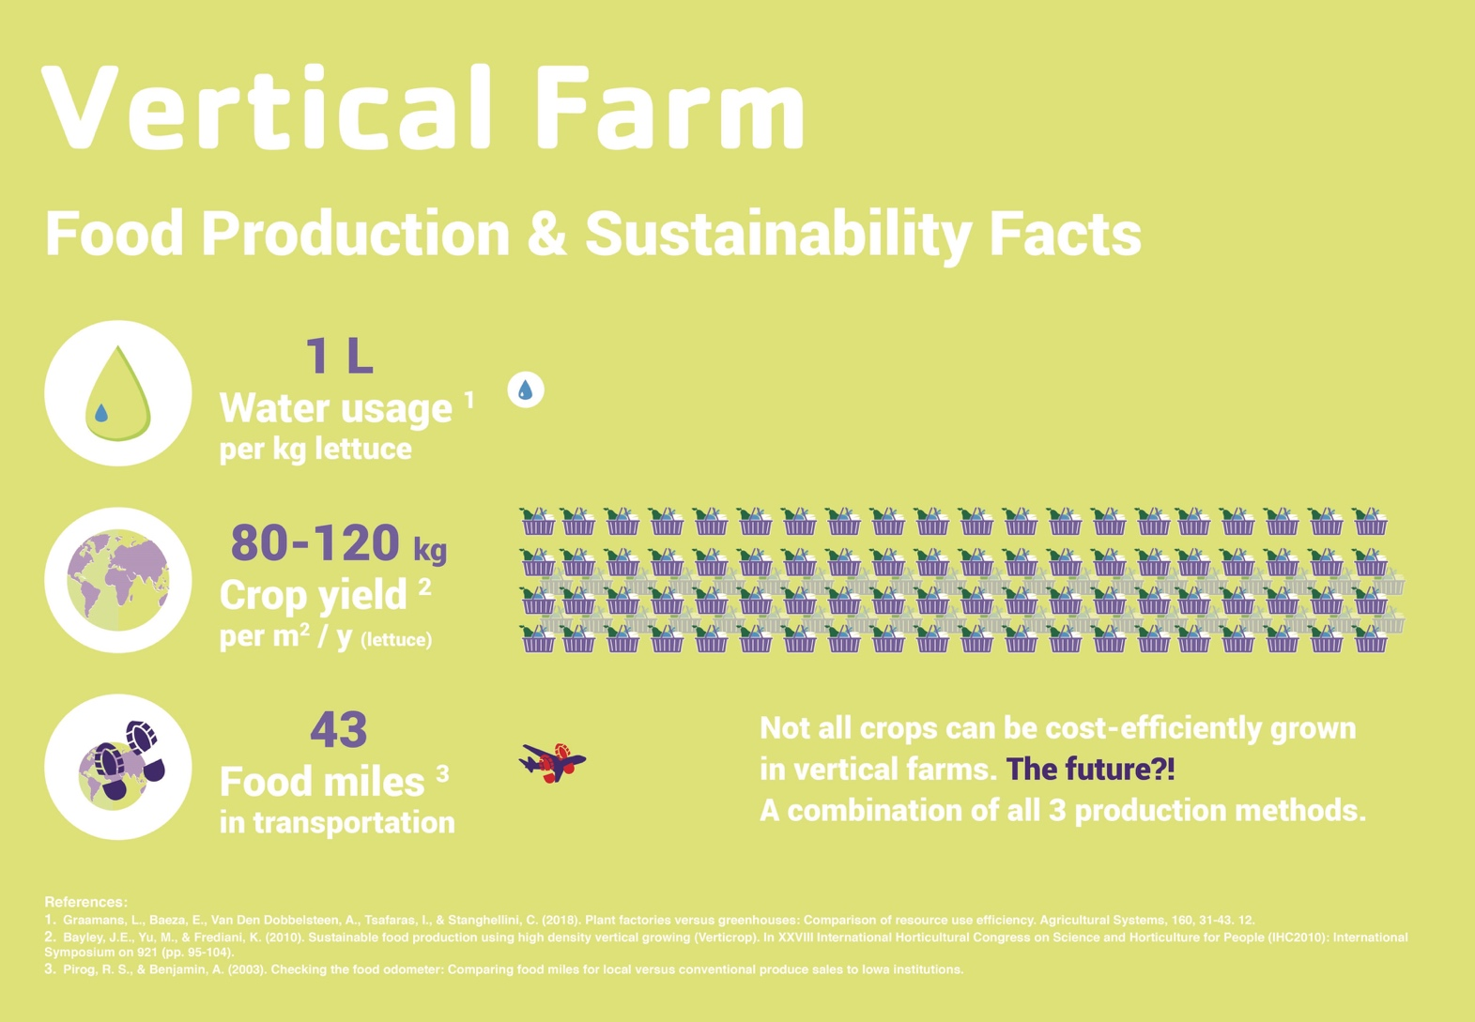

Slide 19
A countryside that works for all
A ‘land use framework’, to agree how we’ll use land for the benefit of all
food or forestry?
housing or infrastructure?
green energy or rewilding?
leisure or business?
A balanced and fair debate about public value

Slide 20
