Slide 1

Food, farming & land use
Indra Thillainathan
Committee on Climate Change
Climate Assembly UK, 9th February 2020

Slide 2

Around 71% of UK land area is used for farming
Contribution to the economy (2018):
Agriculture £9.5bn (less than 1% of GDP)
Forestry output £0.7bn
Around 217,000 farm holdings in the UK
76% farm area owned by 20% of holdings
Agriculture employed 426,000 people (1.5% of the UK labour force)
Forestry employed 16,000 people in 2017.
Notes:
* Land for agriculture is made up of arable and horticultural crops, uncropped arable land, common rough grazing, temporary and permanent grassland and land used for outdoor pigs. It excludes woodlands and non-agricultural land.

Slide 3
Trade (2018)
Self-sufficiency
Imports account for 47% of the food we consume
Exports account for 18% of the food we produce
Exported food, feed and drink makes up 1.9% of global agricultural trade
Source: Defra (2019) Agriculture in the UK
Notes:
Food Production to Supply Ratio (commonly referred to as the “Self Sufficiency Ratio”), is calculated as the farmgate value of raw food production divided by the value of raw food for human consumption

Slide 4
The farming sector accounts for ~9%
(45.6 MtCO₂e) of UK greenhouse gas (GHG) emissions
Land use & forestry
Source: BEIS (2019) Final UK greenhouse gas emissions national statistics 1990-2017.

Slide 5
The farming sector accounts for ~9%
(45.6 MtCO₂e) of UK greenhouse gas (GHG) emissions
Source: BEIS (2019) Final UK greenhouse gas emissions national statistics 1990-2017.

Slide 6
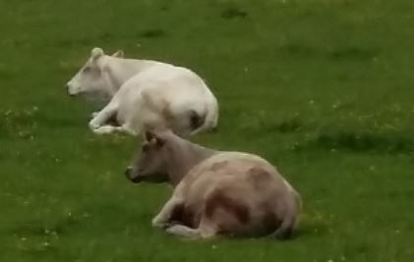
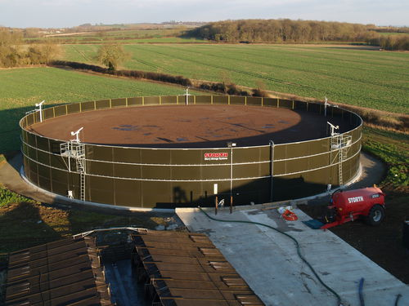
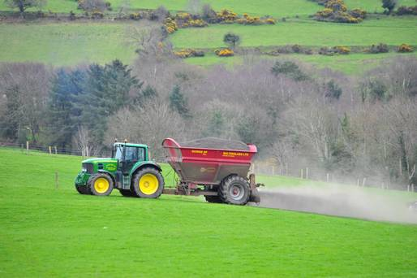
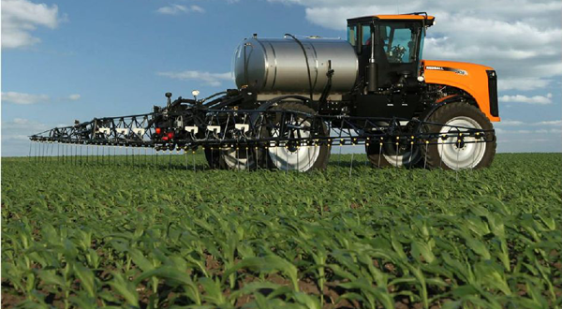
GHG emissions in UK farming come from four main sources
1. Digestion process 47%
3. Storing/managing animal waste 15%
Feed type
Cattle type
Slurry
Farm yard manure
2. Soils (crop and grassland) 24%
4. Energy use by machinery 10%
Chemical fertiliser
Organic fertiliser
Crop residues
Grazing returns
Tractors
Heating, cooling & drying systems
Notes:
Soil Emission can vary by region (wet vs dry); application rate, liquid slurries more than solid manure due to higher nitrogen availability

Slide 7
By type of greenhouse gas, methane and nitrous oxide dominate emissions in agriculture
Due to complex biological & chemical processes associated with crop and livestock production it is not possible to reduce these emissions to zero
Source: BEIS (2019) Final UK greenhouse gas emissions national statistics 1990-2017.

Slide 8
But there are a range of measures that farmers can adopt to reduce emissions
These measure also deliver wider benefits beyond reducing emissions
1. Environmental
Improve water quality
Improve air quality
Improve animal welfare
Soil quality
Biodiversity
2. Economic
Crop and livestock yields
1. Digestion process & livestock
Animal feed (e.g. probiotics)
Improve animal health
2. Soils
Efficient use of fertiliser
Avoid soil compaction
3. Managing /storing animal waste
Adding acid to slurry stores
4. Energy use
Renewable energy (e.g. solar panels)
Electric vehicles / small robots

Slide 9
Eating less beef, lamb and dairy products can also contribute to reductions in GHG emissions
Animal protein sources generally have larger GHG footprints than plant-based sources
Notes:
Lifecycle analysis (LCA) evaluates the environmental footprints of all aspects of the production, processing and transportation of food. LCA
Later on you8 will hear about the importance of diet chane
By ext slide important where it sis sourced

Slide 10
GHG emissions intensity of beef around the world
Source: Poore, J. & Nemecek, T. (2018)
Wide variation reflects the range of different production systems, land conditions and climates across the world.

Slide 11
The way we manage and change the use of land can release emissions and remove emissions (sequestration) from the atmosphere
The UK land use sector is a net emitter of GHG emissions ~12 MtCO₂e
Notes:
Bioenergy and trees on farm

Slide 12
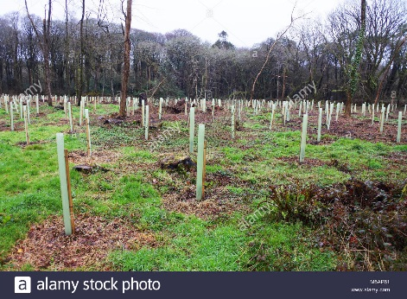
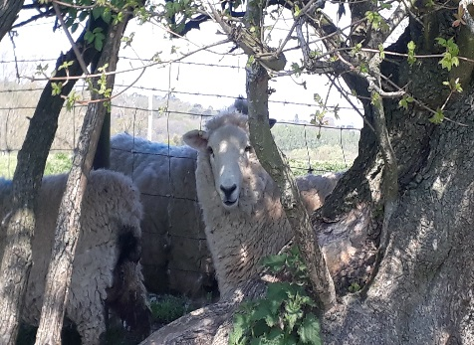
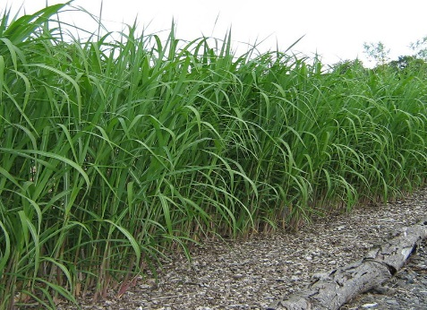
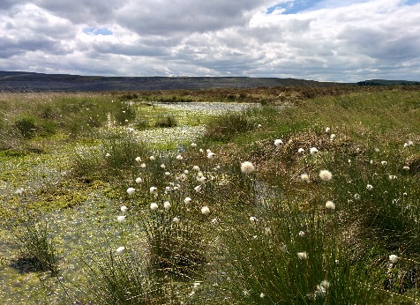
Measures to reduce emissions and increase removals
Planting trees…
…and on farm
Energy crops
Restoring peat
This requires releasing some land out of agricultural production.
This can be achieved through a change in diets (less beef, lamb and dairy), improving crop productivity and increasing livestock stocking densities on grassland.
These measures also deliver wider benefits beyond the reduction of emissions:
- Air quality - Animal welfare - Recreation
- Water quality - Biodiversity - Health
Notes:
Bioenergy and trees on farm

Slide 13
Topics and speakers
1. The role of farming in delivering net zero
Ceris Jones (National Farmers’ Union)
Sue Pritchard (Royal Society of Arts)
2. The role of land in delivering net zero
Jo House (University of Bristol)
3. The role of consumers and behaviour change in delivering net zero
Rosemary Green (London School of Hygiene & Tropical Medicine)
Tim Lang (City University)

