Slide 1
Introduction
Two panels:
What We Buy
Food, Farming & Land Use

Slide 2
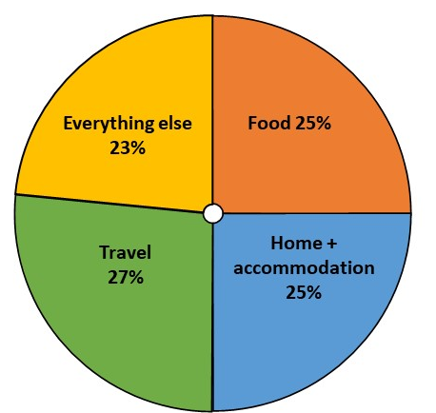

Where do our greenhouse gas emissions come from?

Slide 3
Panel 1. What we buy
This covers things we buy, such as cars, clothing, electronics and appliances (e.g., fridges), furniture, insurance
It includes the energy used to make things we buy or use (from cars, chairs, toothbrushes … to using the internet, insurance, etc.)
Not including food as it will be dealt with separately later

Slide 4
Panel 2. Food, farming & land use
This covers what we eat, as well as how we use the land (for growing crops, grazing livestock, woodland, peatland etc.)
We are looking at food and land together, because farming currently uses the majority of our land in the UK – so decisions about our diets have wider implications for land
Some ways we use land can store or absorb carbon dioxide, whereas others may emit carbon dioxide (CO₂)
Land is not only important for climate change

Slide 5
UK vs overseas emissions
‘Net zero’ laws will only cover emissions produced in the UK
This means we need to focus on UK emissions, but avoid making decisions that lead to more emissions being created abroad
Food and other things we buy often come from overseas
Notes:
. Again, recall that the UK’s Net Zero legislation doesn’t require us to reduce our overseas emissions, but if we want to play our full part in tackling climate change effectively we need to consider our wider contribution to global emissions too. Food systems are global, and we import and export a large amount of food, and animal feed; they are also under increasing pressure from climate change and growing demand from population growth, so decisions about food in reaching net zero need to bear in mind these wider changes.

Slide 6
Things to consider
Evaluate options bearing in mind the principles you agreed in weekend 1
Might also consider things like how options impact on:
employment/skills
different groups and regions in the UK
the UK’s changing climate
nature and natural resources
additional benefits from reducing emissions
Choices also relate to energy supply (weekend 4) and to ‘negative emissions’
Notes:
(i.e., reductions will need to be greater without NETs)

Slide 7
Policy options
Policy = actions that government take
Can include:
  information/advice
  economic measures (e.g., taxes)
  regulations (e.g., bans)
  Business, individuals, government need to work together (but policies vary in who does more)
Government
Businesses
Individuals

