Slide 1
Greenhouse Gas Emissions of our consumption
John Barrett
University of Leeds

Slide 2
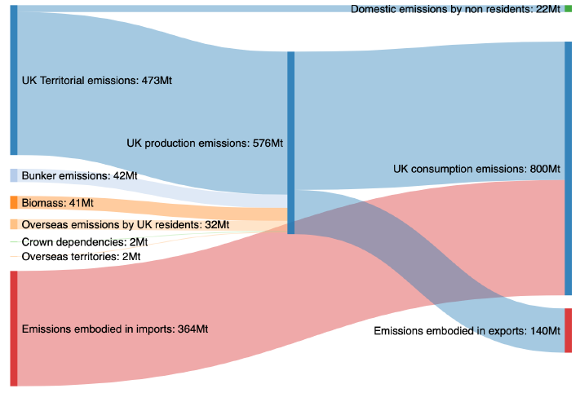
Emissions of our consumption
Source: University of Leeds

Slide 3
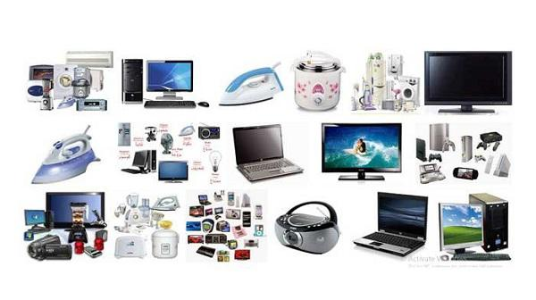
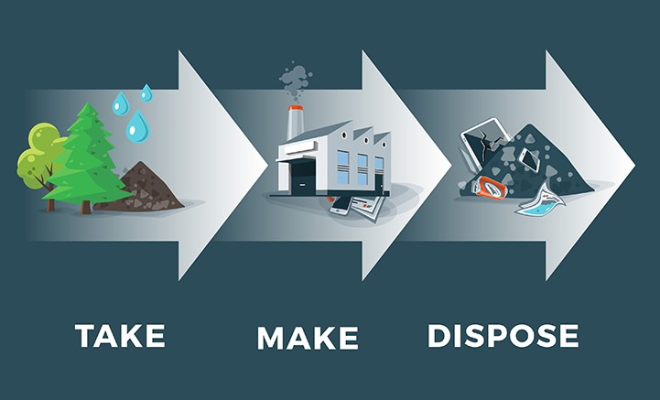



Options for reducing our emissions

Slide 4
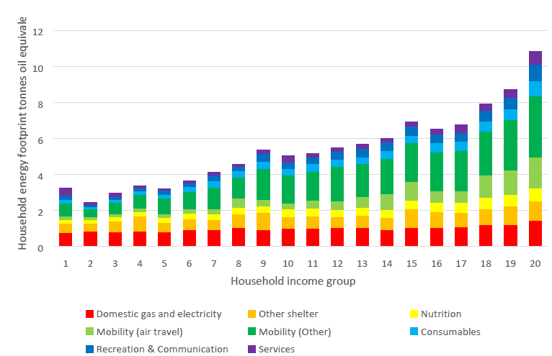
What drives our emissions?
Source: University of Leeds

Slide 5
Avoiding Consumption
Consuming less
Less waste
Using products for longer
Repairing and product design
Sharing economy

Slide 6

Making better products
Resource and energy efficiency
Circular economy
Services instead of goods
Using better materials

