Slide 1

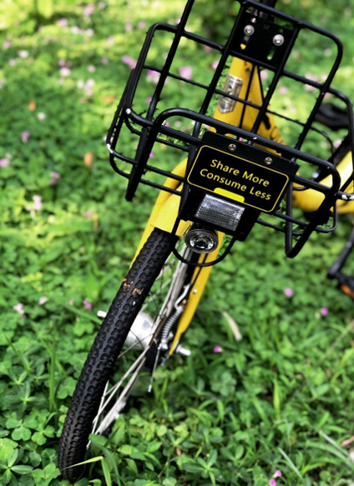
Buying Second-hand,
Renting, Sharing:
The Future of Consumption?
Dr Nicole Koenig-Lewis
Associate Professor (Reader) in Marketing
Cardiff Business School, Cardiff University

Slide 2


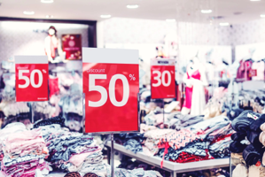
How We Live Today
We live in a consumer society with a ‘Make, Buy, Use, Dispose’ approach to meeting our needs
What households buy accounts
for around 60% of the UK’s economy
E.g. average person buys 60% more clothing today than 18 years ago
1,130,000 tonnes of clothing purchased in 2016 in UK

Slide 3
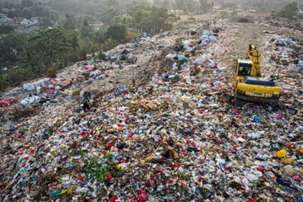
Consequences of Consumption
Running out of natural resources
Increased pollution & too much waste
300,000 tonnes of clothing send
to landfill/incinerator
80% of household items used less
than once a month
Power drill used on average 18 minutes in its lifetime
Average car – 80% of time parked at home & idle 96% of time
30% of clothes in our wardrobes
unused for at least one year

Slide 4





Alternative Approaches
Buying, selling and renting pre-owned goods becoming more socially acceptable as an alternative to the traditional ownership of goods
(Campana, Chatzidakis and Laamanen, 2017)
Repair (e.g. Restart Project, Repair Café )
Second-hand and Remanufactured Goods
‘Sharing Economy’ (Renting/Sharing)
  Ownership not central to identities
  (Garcia, 2013; Kathan, Matzler & Veider, 2016)
Notes:
Campana, M., Chatzidakis, A., & Laamanen, M. (2017). Introduction to the Special Issue: A Macromarketing Perspective on Alternative Economies. Journal of Macromarketing, 37(2), 125–130. https://doi.org/10.1177/0276146717700228
Garcia, H. (2013). Consumption 2.0. Futurist, 47(1), 6-8
Kathan, W., Matzler, K., & Veider, V. (2016). The sharing economy: Your business model's friend or foe? Business Horizons, 59(6), 663-672. doi:https://doi.org/10.1016/j.bushor.2016.06.006

Slide 5
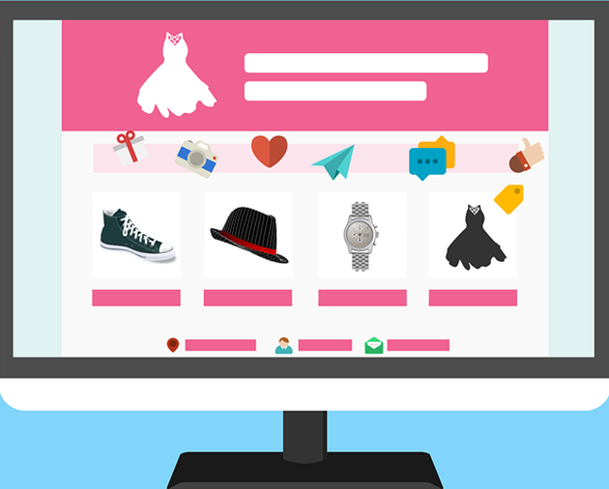




Second-Hand Economy
Business-to-Consumer
Business-to-Business
Manufacturer/Retailer
e.g. Amazon Renewed
Consumer-to-Consumer
e.g. Ebay, Gumtree, Vinted…
e.g. Freecycle, Freegle, Craiglist, Swopped, Swapz,….
Ownership Transfer
(Donating, Swapping, Gifting, Selling Pre-owned Goods)
Users
Owner/ Seller
e.g. Car Boot Sales, Charity Shops

Slide 6
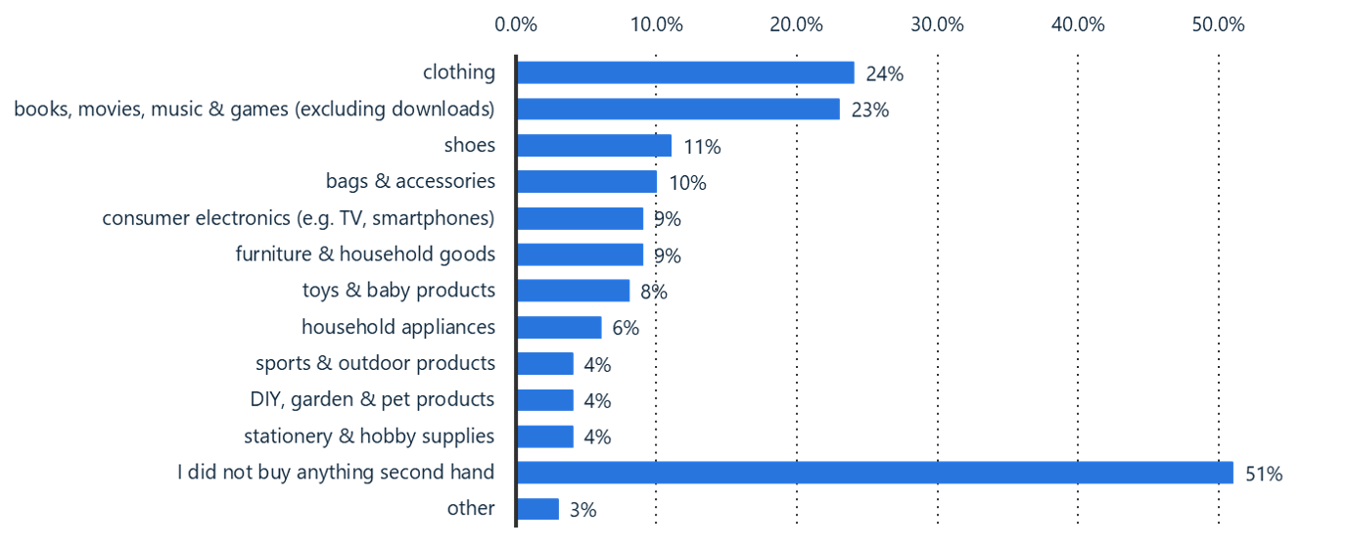

Commonest UK Second-Hand Buys 2019
Note: United Kingdom; February 28 to March 08, 2019; 18-64 years; 2038 Respondents
Further information regarding this statistic can be found on page 8.
Source(s): Statista Global Consumer Survey; ID 997906
Notes:
Source: Statista 2019. Which of these articles have you bought second hand in the past 12 months (no matter if online or in person)? Available at: https://www.statista.com/forecasts/997906/second-hand-purchases-by-category-in-the-uk

Slide 7
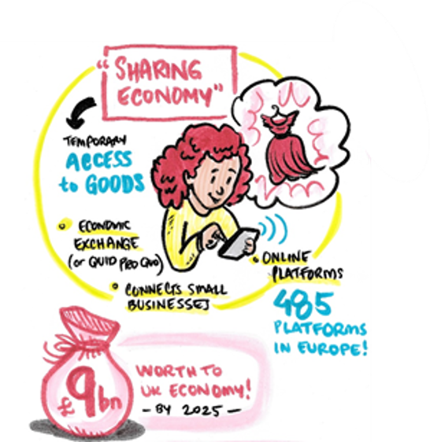
Sharing Economy Size
  Sharing economy worth £9 billion to UK
  economy by 2025 (PWC 2015)
  62% of UK population participated in
  sharing economy (includes second-hand goods)
  31.5% of non-users never heard of sharing
  economy (WBS, UK Sharing Economy Consumer Survey 2017)
  Sharing platforms for accommodation,
  mobility, clothes, toys, things, services
Visual by Laura Sorvala
Notes:
PWC (PriceWaterhouseCooper) 2015. The Sharing Economy, available at https://www.pwc.fr/fr/assets/files/pdf/2015/05/pwc_etude_sharing_economy.pdf [accessed 20.01.2019)
Ozcan, Pinar, Möhlmann, M. and Krishnamoorthy, Chandy (2018) Who shares and who doesn't? Results of the UK Sharing Economy Consumer Survey 2017. Warwick: Warwick Business School. (available at http://wrap.warwick.ac.uk/103410/7/WRAP-who-shares-and-who-doesn%2527t-results-UK-sharing-economy-Mohlmann-2018.pdf)
European Commission (2017). Exploratory study of consumer issues in online peer-to-peer platform markets. Report available at: https://ec.europa.eu/info/sites/info/files/final_report_may_2017.pdf [accessed 20.12.2020]

Slide 8
Sharing Economy
Business-to-Consumer
Business-to-Business
Owner
e.g. ZipCar, Stich Fix, BuildUrBricks,
Belles and Babes,
Library of Things,
Product-Service-Systems
Membership fee + Pay per use
Subscription
Consumer-to-Consumer
e.g. AirBnB; hiyacar, HURR,
Our Closet
Users
Owner
Renting, Sharing, Lending without
transfer of Ownership

Slide 9
In the News….
Kitchen for rent? Ikea to trial leasing of furniture
4 Feb 2019, The Guardian
Retailer to test idea of renting office furniture – but home products could be next
Lego looks at putting together potential rental service
October 14 2019, Financial Times
Scheme is one of several ideas being considered as part of sustainability drive
H&M to trial clothing rentals for the first time
October 28 2019, H&M website
H&M is launching its first clothing rental service at its newly refurbished Sergels Torg store in Stockholm, Sweden.

Slide 10
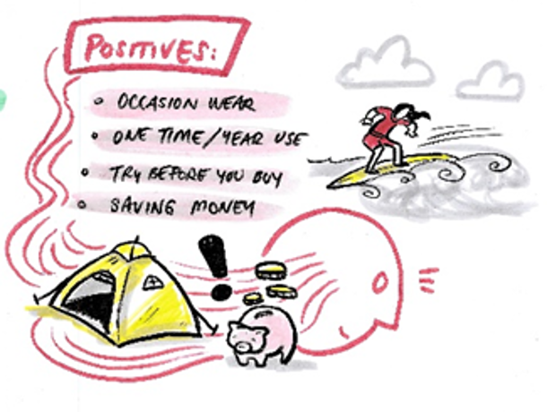
Benefits
Reducing CO₂ emissions and
use of raw materials
Reducing waste
Extending product lifespan
People can access goods
Economic opportunities
Empowering people (e.g. micro-entrepreneurs)
Fostering community connections (e.g. well-being)
Social space to meet and learn new skills
Visual by Laura Sorvala

Slide 11
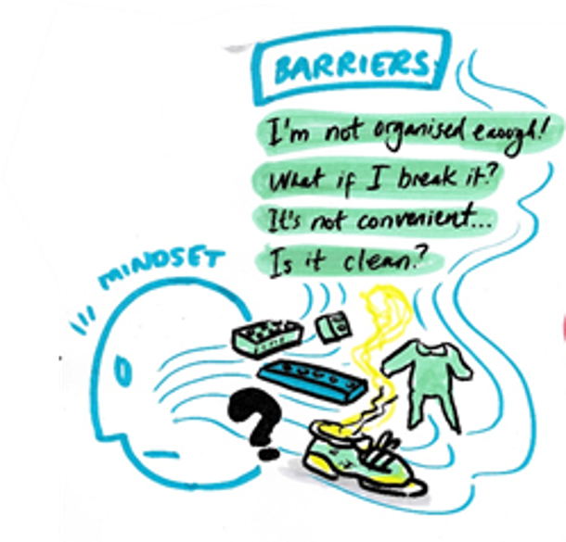
Barriers
Consumption habits
Unawareness/Knowledge
Safety concerns
Hygiene concerns
Insurance/legal concerns
Convenience of ownership
Lack of trust
Personal data concerns
Visual by Laura Sorvala

Slide 12
Unintended Consequences
Increased emissions from transport
Emissions from cleaning of shared goods
Increased consumption
e.g. People use money saved by renting to buy more stuff
People change products more frequently
People not taking care of rented products
Highly flexible but insecure forms of employment
Notes:
Acquier, A., Daudigeos, T., & Pinkse, J. (2017). Promises and paradoxes of the sharing economy: An organizing framework. Technological Forecasting and Social Change, 125, 1-10. doi:https://doi.org/10.1016/j.techfore.2017.07.006
Parguel, B., Lunardo, R., Benoit-Moreau, F., 2017. Sustainability of the sharing economy in question: when second-hand peer-to-peer platforms stimulate indulgent consumption. Technol. Forecast. Soc. Chang (125).
Verboven, H., & Vanherck, L. (2016). The sustainability paradox of the sharing economy. uwf UmweltWirtschaftsForum, 24(4), 303-314. doi:10.1007/s00550-016-0410-y

Slide 13

Summary
Alternative consumption approaches around ‘Reuse’ – potential to change consumption habits
Shift in mindset needed - Ownership not necessary
Increased producer and retailer responsibilities – offering high-quality products which last longer and designed
for re-use
Regulations, Warranties, and Guarantees
“On the whole, you find wealth much more
in use than in ownership.” Aristotle

