Slide 1

An understanding of how growth in demand for air travel could be reduced
Leo Murray
Director of Innovation at Possible
Notes:
Innovation can be social as well as technological!

Slide 2
Forecast growth in number of flights must be reduced to meet Net Zero target
Technology improvements are essential but even if we are optimistic, these won’t be enough on their own to fix problem
Experts agree that we cannot achieve Net Zero if demand for more flights is allowed to grow without any constraints
The government’s official advisors the Committee on Climate Change say that air travel can grow, but by no more than 25%
The government forecasts that demand for flights will grow by about twice as much as this (50%) to 2050
Notes:
“Aviation Demand Management’s Role in Deep Decarbonisation Pathways”, Possible own analysis, due to be published March 2020 https://docs.google.com/document/d/1AoAxxTI7Yqk35DspUbJ0RrKOQ7FHL8mvdAR5VnXR2cw/edit?usp=sharing
15 pathways analysed; ICAO and IATA targets are not compatible with Paris agreement. Only Ecofys suggest that a Paris-compliant pathway for aviation can be delivered with unconstrained growth (through biofuels and efficiency), and their scenario is uncosted so likely to simply omit price effects on demand altogether
https://www.theccc.org.uk/wp-content/uploads/2019/09/Letter-from-Lord-Deben-to-Grant-Shapps-IAS.pdf

Slide 3
Policy options for managing demand for air travel: key challenges
Whatever happens, flying has to become more expensive
Generous tax breaks have kept the cost of flying artificially low relative to other travel options
People have become accustomed to cheap flights
International nature of air travel makes national policy tricky
The United Nations’ global regulator responsible for decarbonising air travel is not doing their job properly
Notes:
Clearly a global solution to global sectoral emissions from air travel would be ideal, but there are no signs of this materialising. The global regulator is a UN body called the International Civil Aviation Organisation (ICAO) that is responsible for setting and enforcing rules governing international air travel. They have had formal responsibility for delivering a global aviation decarbonisation strategy since Kyoto in 1997, but as of 2020 they have yet to approve any measures that impact meaningfully on aviation’s emissions growth. Historically, ICAO’s main role has been to promote the growth of civil aviation worldwide, so there are fundamental tensions to overcome here.

Slide 4
Taxing air travel: fuel duty
International jet fuel has been completely untaxed since 1944 Chicago Convention was introduced to boost air travel
The Convention is widely seen by governments as legally blocking any moves to tax jet fuel
For comparison, taxing jet fuel at the same rate as UK fuel duty on petrol at the pump would add £43 to the price of a return ticket to Barcelona, or £200 to New York and back
Notes:
It is not entirely true that the many bilateral treaties that make up the Chicago Convention completely prohibit the taxation of kerosene for international flights, but this interpretation is widely held and caused the UK government to drop plans to replace Air Passenger Duty with a per plane tax in 2012, on the grounds that it would be too similar to a fuel tax hence vulnerable to international legal challenge. https://researchbriefings.parliament.uk/ResearchBriefing/Summary/SN05094#_ftn5
Comparison is for economy class tickets
some countries (eg the US) tax fuel for domestic flights at a low level

Slide 5
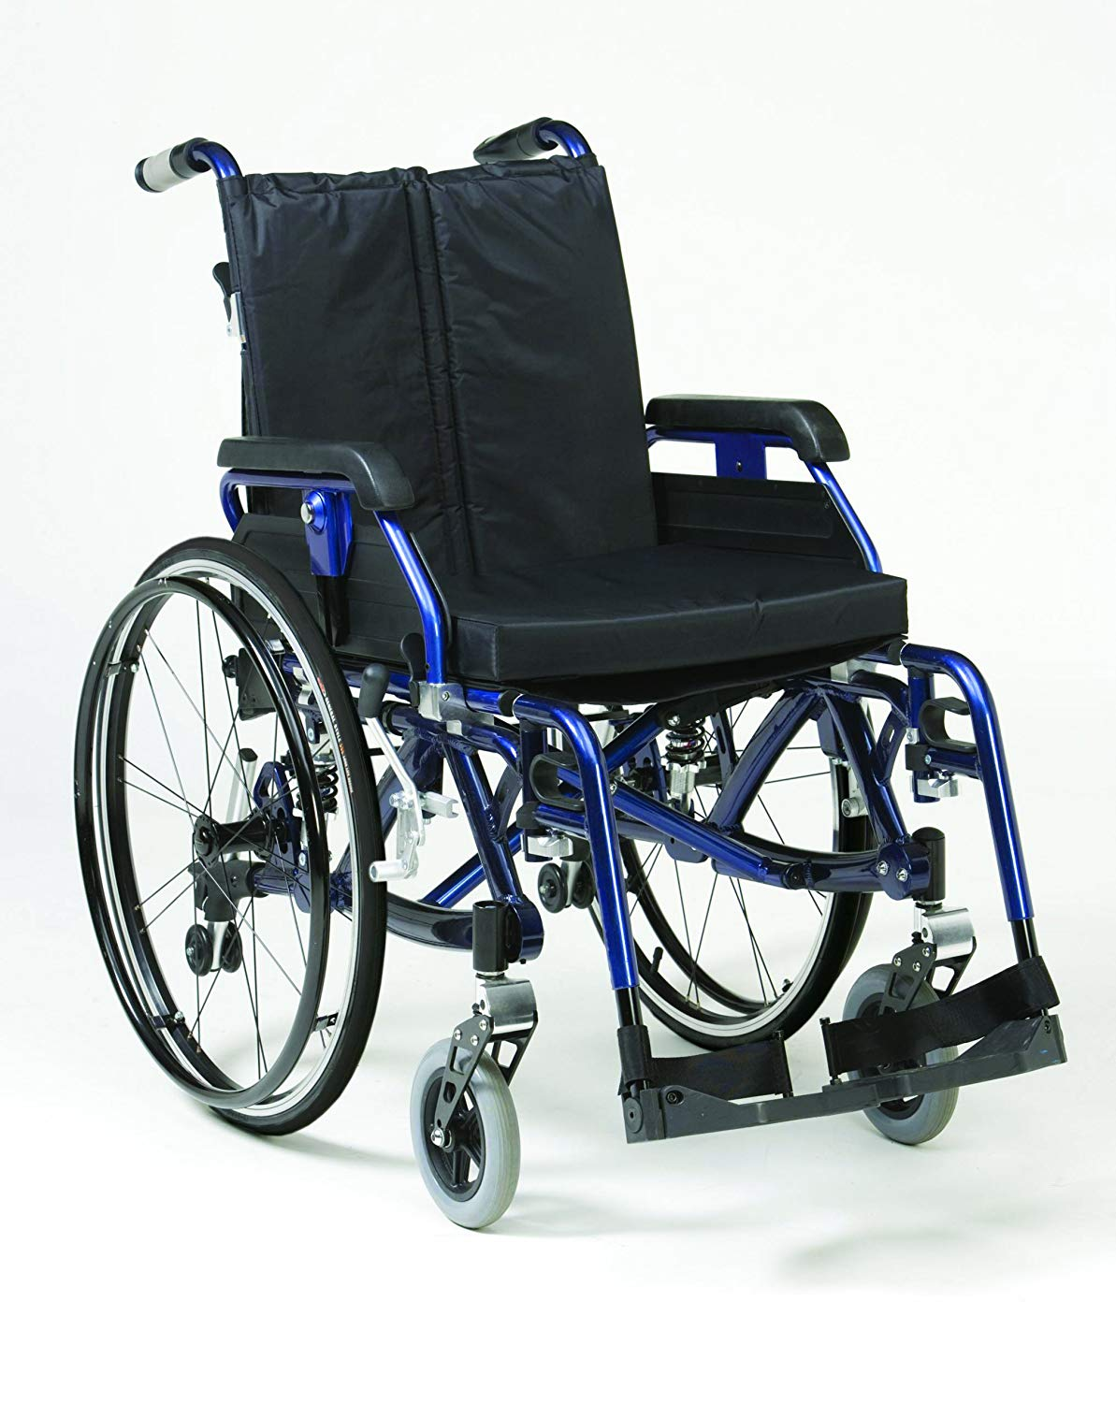
Taxing air travel: VAT
Plane tickets are also 0% rated for VAT, alongside items like wheelchairs and baby clothes
For comparison, items like tampons and solar panels pay a reduced rate of 5% VAT, while bicycles pay the full 20%
Notes:
https://researchbriefings.parliament.uk/ResearchBriefing/Summary/SN05094#_ftn5
https://researchbriefings.parliament.uk/ResearchBriefing/Summary/CBP-8602
The aviation sector also benefits from Duty Free shopping at airports and direct public subsidies to support some domestic routes.
https://www.gov.uk/government/news/new-regional-air-routes-offer-fast-journeys-across-uk-and-europe
Some EU countries, such as the Netherlands, charge reduced rates of VAT on domestic flights, and there is no barrier to the UK doing similar today. After Brexit, the UK will be free to set its own rates of VAT for international flights.

Slide 6
Taxing air travel: Air Passenger Duty
The UK charges Air Passenger Duty (APD) on most tickets for flights departing from the UK
Almost all passengers pay the reduced rate of £13 for short haul economy class travel, or £78 for long haul
APD raised just over £3.6 billion for the Treasury in 2018/19
But APD would need to raise three times as much to make up for VAT & fuel duty exemptions
Public purse effectively out of pocket by £7.4 billion per year
Notes:
APD not charged on international transfer flights and under-16s, and certain other passenger classes such as medical and military flights.
94% of UK air passengers pay the reduced rate – 78% short haul (Band A) and 16% long haul (Band B)
https://www.uktradeinfo.com/Statistics/StatisticalBulletins/Pages/BulletinArchive.aspx?viewname=Air%20Passenger%20Duty%20Archive
Foregone tax revenue of ~£2bn VAT and ~£9bn fuel duty.
Many countries have air departure taxes of some sort, although the UK’s are comparatively high

Slide 7
Carbon offsetting: overview
Carbon offsetting is the practice of increasing emissions from one source while paying for them to be reduced by the same amount elsewhere, in theory ‘neutralising’ the new emissions
Carbon offsetting is preferred by industry as a cheaper and easier alternative to reducing emissions from air travel itself
Evidence that offsetting actually works reliably is very poor
Notes:
The problems with offsetting are too many and varied to cover in this presentation. A recent EU study found that 85% of carbon credits sold under the UN’s previous flagship offsetting scheme, the Clean Development Mechanism (CDM), did not deliver any emissions reductions. https://ec.europa.eu/clima/sites/clima/files/ets/docs/clean_dev_mechanism_en.pdf Airlines want CDM credits to be eligible under the new CORSIA scheme.

Slide 8
Carbon offsetting: plans
The United Nations’ global regulator is planning to introduce a global offsetting scheme for air travel called CORSIA
The scheme is intended to offset only the planned growth in carbon emissions from air travel from 2020 onwards – a goal that is not aligned with keeping warming below 2ºC
CORSIA is expected to add a few pence to the price of a typical short haul ticket in 2030, and £1 to long haul
Notes:
A thorough write up of the CORSIA plan and widespread concerns over its effectiveness can be found here: https://www.carbonbrief.org/corsia-un-plan-to-offset-growth-in-aviation-emissions-after-2020

Slide 9
Carbon Pricing: overview
This is where businesses pay for permits to emit carbon, with the price set so that the upper limit of emissions is capped
Flights within Europe are subject to the EU Emissions Trading Scheme (ETS), which adds a ‘carbon price’ of around £1-2 to a typical ticket price today
The aviation industry is lobbying for the ETS to be scrapped for flights when CORSIA offsetting scheme is introduced
Notes:
Airlines benefit from mostly free carbon permits under the EU ETS.
Workings out here https://docs.google.com/spreadsheets/d/1yKX_01pBdRd-1J-IgPF8eqparNfLTfw6OCbj_dNMN-I/edit?usp=sharing

Slide 10
Carbon Pricing: future projections
Even though the government includes an escalating carbon price that reaches £221 per tonne in 2050 in their forecasts, they predict that flying will still grow by around 50% by 2050
So, additional policy measures to limit demand growth to 25% are needed even if this carbon price happens
But there are in fact no policy plans to introduce this carbon price, so flying will grow by even more than 50% without it
Notes:
https://www.gov.uk/government/publications/uk-aviation-forecasts-2017

Slide 11
Managing demand by increasing Air Passenger Duty
Pros
As the only existing tax levied on air travel, the simplest policy option for managing demand would be to increase APD
Changes can be made easily and immediately
Cons
APD rates do not match emissions as closely as a carbon price would
APD is levied on passengers not planes, so does not incentivise airlines to fly more efficiently

Slide 12
Managing demand through airport capacity constraints
Pros
Existing UK airport capacity is sufficient to handle entire ‘allowed’ 25% increase in flights, with no further expansion needed
Cons
If Heathrow gets a third runway, airport capacity elsewhere would need to be reduced by 10% to stay within the safe limit - equivalent to closing Manchester airport
Current expansion plans across all UK airports would increase total capacity by considerably more than 50%
Notes:
https://www.carbonbrief.org/guest-post-planned-growth-of-uk-airports-not-consistent-with-net-zero-climate-goal
Constraining supply while demand rises would create scarcity, and the market will respond by raising ticket prices by between a quarter and a third, with price rises likely concentrated at the most popular airports (NEF / Possible – new analysis for publication in March 2020). This would increase profit margins for airlines (though not necessarily overall profits) but would not generate new tax revenues to help pay for transport decarbonisation, or compensate for the fact that air travel is currently very under taxed compared to other transport modes and other leisure activities.

Slide 13
Managing demand with a Frequent Flyer Levy
A levy on frequent flyers could replace Air Passenger Duty
  Low or zero tax for one flight per person per year
  Increasing amounts of tax for each additional flight within a 12 month period
  Most people unaffected or better off
  Shifts rising tax burden onto those who fly the most
Notes:
Managing aviation passenger demand with a Frequent Flyer Levy, NEF 2015
https://s3-eu-west-1.amazonaws.com/media.afreeride.org/documents/FFL+Modelling+paper.pdf

Slide 14
Demand management through increased prices - fairness
Meeting Net Zero target means some flights must be stopped in the future, and this means that overall the cost of flying must rise
Relying on Air Passenger Duty increases, carbon pricing or airport capacity constraints would mean most of the reduction in flights to 2050 comes from those on below average incomes, who rarely fly currently
Using a Frequent Flyer Levy instead would mean most of the reduction in flights comes from those on above average incomes who fly very often
Notes:
NEF / Possible – new analysis for publication in March 2020

Slide 15
Concluding thoughts
UK airport expansion is not consistent with Net Zero goal
Price increases are needed, but most options would hit lower income flyers hardest
A Frequent Flyer Levy could be an effective way to manage growth in demand for flights within safe limits, while protecting access to some air travel for all income groups
Legislating a FFL may be hard as most politicians and other power holders are in the frequent flyer minority themselves
Notes:
Finally, it is important to note that the exceptionally generous treatment of aviation under the central UK Net Zero scenario implies additional cuts must be made by other sectors of the UK economy to compensate for the air travel sector making no contribution to absolute emissions reductions. As air travel is fundamentally a luxury, with the majority of flights being overwhelmingly for discretionary leisure travel by those in the top half of the income spectrum, the very large share of overall residual UK emissions allocated to aviation (over 40%) under the central 2050 Net Zero scenario may not be optimal, or even viable. If this share is reduced to accommodate smaller reductions in more essential sectors such as home heating; if negative emissions technologies do not materialise at the scale envisaged; if non-CO2 warming impacts of aviation are accounted for in the framework; or if a nearer-term target date for Net Zero than 2050 is adopted; then additional reductions in demand growth, and potentially absolute reductions in overall demand for air travel will be required to achieve Net Zero targets.
Reports, briefings and further analysis available at www.afreeride.org/wonkery

