Slide 1

UK100: Who we are
UK100 is a network of highly ambitious local government leaders, who have pledged to secure the future for their communities by shifting to 100% clean energy by 2050.

Slide 2
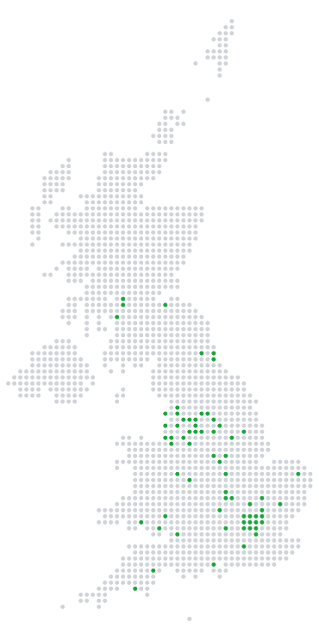
UK:100 Progress … 22% of UK CO2 emissions
96 Local Authorities
have committed to:
100% clean energy before 2050,
in line with the commitments made nationally and internationally at the Paris Summit

Slide 3
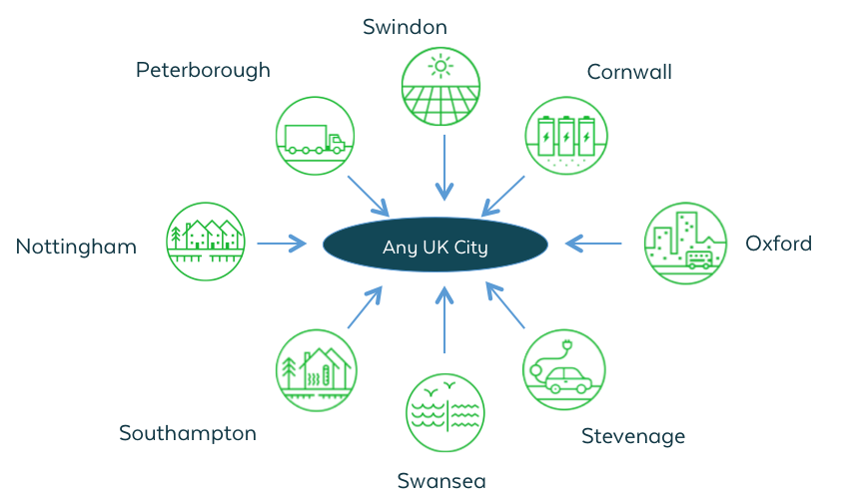

UK:100 Every place with place-based solutions

Slide 4
UK:100 – What we know about heat
Heat is local
There are limits on what local authorities can do
Could play crucial role: planning, enabling, directing
BUT need powers – responsibility and ability to act
Some examples: Olympic Park – allowed to start small & grow

Slide 5
Heat is local:
What can local leaders do?
What have you got?
  Think in terms of energy, heat and powers
What do you want to achieve?
  Reduce bills, generate income, cut pollution, create jobs

Slide 6
Heat is local: UK examples
Enfield – new energy from waste
Southampton – geothermal source
Leeds – new city centre system/hydrogen

Slide 7
Heat is local:
International examples
Vancouver – establish guidelines for collaboration with private sector
Copenhagen – work across districts: 5 mayors in 1984
London – map heat sources

Slide 8
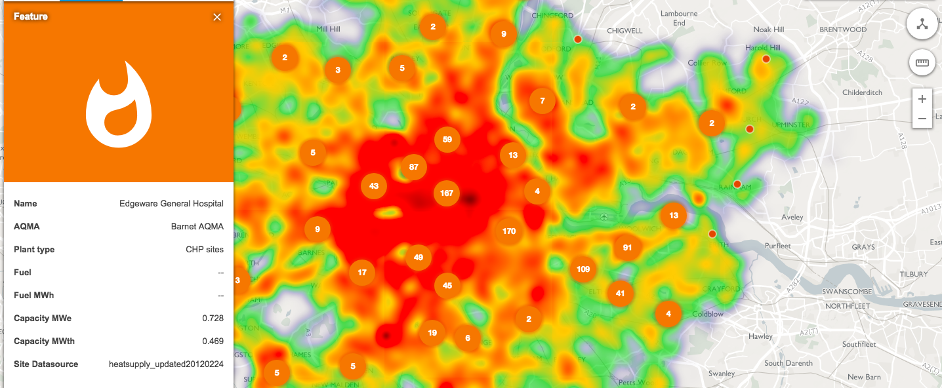
London’s Heat Map

Slide 9
Heat is local:
What works now
European Funding – will need a replacement!
Heat Network Development Unit – help from government in terms of advice and guidance
Local Energy Hubs (England) supporting projects

Slide 10
Heat is local:
The problem with power (London)
Lots of powers on public transport & roads
Very few powers on energy generation or supply
SO … think creatively: Transport for London owns land and generates heat.
AND … ask for the powers you need

Slide 11
Heat is local:
What needs to change (1)
Give more powers to local leaders so they can make sure the heat networks are built.
Local leaders need to have a master plan for energy, like they do for health and social care.
The Government could require local authorities to develop heat and energy efficiency strategies (but this will need money).

Slide 12
Heat is local:
What needs to change (2)
Local authorities should be able to require developers to connect to district heating networks.
Planning guidelines to recognise the need for clean heat.
Ofgem rules to allow heat networks to be built before homes are built.

Slide 13
Heat is local:
What needs to change (3)
Regulate Heat! (Ofgem doesn’t regulate the price or cost of heat)
Everything is connected (electricity, building standards, even transport)
The solution won’t be the same everywhere
Keep the economic benefits local too.

Slide 14
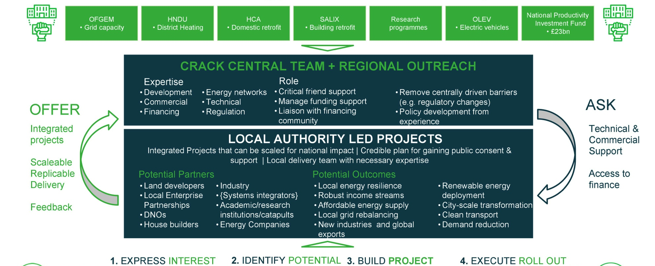
Heat is local:
What needs to change (3)

