Slide 1

Who is Energy UK?
We are a membership body working in energy
We represent energy suppliers (e.g. British Gas, EDF Energy, Octopus, OVO) and power companies (e.g. wind and solar farms through to nuclear power plants)
Notes:
Dan Alchin of Energy UK
Organisation representing energy suppliers. Like British Gas, EDF Energy or Scottish Power. As well as the likes of Bulb Energy, Octopus Energy or OVO Energy.
Also represent power generators, the companies that operate the power plants in this country. All different technologies, wind and solar farms through to nuclear power plants.
Here to talk about the role of the private sector, businesses, in reducing emissions in the home.
Believe that business and competitive markets have a key role to play.
What do I mean by businesses

Slide 2
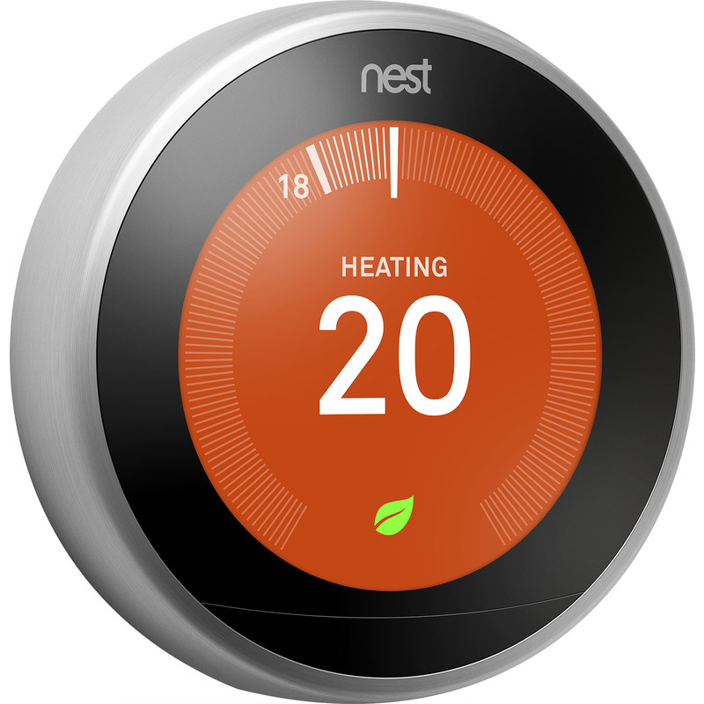
What will businesses be doing in the future?
Selling and fitting boilers, insulation, heat pumps, etc.
Servicing and repairing them
Finance (e.g. Green loans and mortgages)
Bringing out new products and services for households
Notes:
I see four big roles for business in helping you improve your home:
Like today businesses will continue to be the ones selling and installing boilers, insulation and heat pumps.
This includes servicing and repairs
Also a big role for businesses in financing improvements.
Could also be in the form of green loans and green mortgages to help us pay for the new technologies that we will need to reduce carbon emissions in the home, which will generally come with a higher upfront cost.
Businesses will also be at the forefront of driving innovation. Both in bringing forward new products but also new ways of interacting with users.
Technologies that help reduce emissions – such as heat pumps or smart thermostats, like Nest and Hive– will need to be installed, and new technologies will need to be developed.
How energy is packaged and sold may also change, new ways of interacting with businesses could emerge.

Slide 3

What businesses have already achieved
Improved over 2m homes since 2013
Fit over 1m new boilers each year
Put in 100,000+ renewable heating systems since 2014
Created 225,000+ low carbon jobs (engineers, plumbers, electricians, builders etc.)
Notes:
Energy companies have improved over 2 million homes since 2013, like loft insulation, new boilers and filling cavity walls.
There is also a strong private market for boiler installation and repairs with over 1 millions boilers being installed each year.
Businesses have installed over 100,000 renewable heat systems in response to Government incentives.
These activities contribute to a growing number of people work in low carbon jobs, including key trades like gas engineers, electricians, builders and plumbers.

Slide 4

Case study: Energy Companies Obligation (ECO)
Law making big energy suppliers help poorer homes save energy
Currently the only nationwide scheme to improve the energy efficiency of homes
Paid for by energy suppliers who raise the money through energy bills
Notes:
Energy Companies Obligation
How we have improved those 2million homes since 2013
So what is ECO.
Well Government passed a law, requiring the largest energy suppliers to install loft insulation, cavity wall insulation and new boilers to help poorer households who are struggling with their energy bills.
A scheme like this has existed in some shape or form since 1994.
Energy companies pay for the improvements and then costs are shared across all of our energy bills – adds about £26 a year to all our bills.
Important thing to note, currently the only GB wide programme to improve homes – if you live and England and have had work done good chance it was under ECO

Slide 5
What are the challenges?
Households do not want to buy energy efficiency or renewable heat. Why?
  Expensive and disruptive
  “Should be free”
  Does not currently increase the value of your home
  Who is responsible for rented homes (landlord v. tenant)
Notes:
Have talked a lot about progress to date. But that has been largely driven by govt support like the Energy Company Obligation and incentives.
However, it is estimated that over £5bn annual investment is needed to meet the energy efficiency targets the government has set itself for 2035
In an ideal world, government would help us all pay for it, but that is perhaps not realistic and may not be the cheapest way of meeting our goals.
My view is that the transition is not possible without private business. We need the private sector’s investment, resources and skills and most of us are going to have to pay for improvements ourselves
Yet at the moment that looks very unlikely.
Currently, to put it simply, the majority of people are not willing to spend their own time and money on energy efficiency improvements or renewable heat systems.
Why:
Most home energy improvements will be expensive and disruptive.
Yet for 30 years have been free of charge. Has set the expectation that such improvements should be free.
Furthermore, unlike a new kitchen or bathroom, improvements are unlikely to add value to your home. So why do it?
Further challenge in that 20% of households live in private rented accommodation. Who is responsible for paying for and arranging works. Short term benefits (energy bill savings, improved comfort) go to tenants. Landlords do benefit in the long term, but have to face the cost at the start.

Slide 6
Recommendations
  New Rules to make people improve their homes.
  New Incentives to encourage people to improve their homes.
  Standards for high quality work, combined with nationwide awareness campaigns.
Businesses can then do their job
Notes:
These challenges are not unique to the UK
Other countries (Germany, France, the Netherlands, and closer to home Scotland) have thriving businesses and markets that are helping people like me and you cut bills and live in more comfortable, healthy and attractive homes.
How have they done it, what do we need to do?
We need:
Well we need a genuine strategy and plan, which includes:
New laws that’s set long term government targets - Energy UK has long called for Government to require a certain level of energy efficiency to be able to sell or rent your home. We already have similar, all be it much less ambitious rules in place today for rented homes.
We need new incentives to encourage people to make changes and comply with any new laws.
Examples of incentives could include:
tax credits for low carbon home improvements,
lowered rates of VAT,
very low or no interest government-backed loans,
Or Stamp Duty or Council Tax variations.
This then needs to be supported by high performance standards, so that we all know what we are purchasing and national communications and marketing campaigns to raise awareness, supported by the availability of local advice for households on the ground.
If you do these things. You give people the reasons and ability to invest their own money in their homes and give business certainty that if they launch products and services people will be interested in buying them.
Furthermore you will drive the growth of new businesses, creating jobs and generating tax revenues.

Slide 7

How to ensure fairness
Not everyone will be able to afford to improve their home.
Government support will be needed to help them.
Notes:
Now that obviously leaves a key question about those who cant afford to make improvements.
No matter what incentives or laws are in place, it is clear some people will not be able to afford to invest in their home.
From our point of view, this is where government needs to take a lead
Fundamentally there is a need for a government funded programme of support to help poorer households who cant afford improvements – we already have examples of such schemes in both Scotland and Wales.
Yes we do today have ECO, but the level of support is not enough. It is also not ideal as the cost of ECO is paid for by all of us regardless of our ability to afford it, would be much fairer if it came out of general taxation.
We must ensure that nobody is left behind or forced to live in a cold, damp and unhealthy home.

