Slide 1

Energy and heat in the home
Consumer protections and fairness
Notes:
Citizens Advice is required by law to represent energy consumers.
I am going to talk about people as users of the energy market.
Consumer protections exist to protect the public (and people who buy or use services and goods) against unfair practices in the marketplace. Consumer protection measures are often established by law.
My presentation is about how and why we should protect people as the energy market changes

Slide 2
This is what I will cover
Why is it important to protect people
Why is it important to be fair?
What happens at the moment?
What needs to happen next?
Notes:
Everybody needs access to energy for warmth and light
Regulator – explain

Slide 3
Why is it important to protect people?
Everyone needs energy BUT our homes need to change (efficiency & low carbon heat)
What is vulnerability?
Its hard to make big decisions
Different information and support needs.
What about if and when things go wrong?
Notes:
Everybody needs access to energy for warmth and light. BUT our homes need to change (efficiency & low carbon heat and electric vehicles) – I won’t talk too much about that as you’ll have heard a lot from previous speakers
New technology, potentially big changes to the ‘stuff’ in your home and the different ways you might buy energy (for example you might have a tariff and appliances in your home that automatically switch on to use energy when its cheapest)
We need to think about whether everyone can make decisions and benefit from these changes – people need to understand why these changes are coming, they’ll need information and support to help make them and they’ll need somewhere to turn when things go wrong.
Without these things public support could be lost and without public buy-in it will be impossible to achieve net zero.
What is vulnerability?
It’s about your situation. Vulnerability can be static i.e you might need extra support and you might always need it, but also it is something that changes, and anyone can be vulnerable at different points in their life (for example if you lose your job, or are bereaved, or have an accident). Also in energy things like being pregnant or having your children mean its even more important you don’t lose the power or heat in your home)
Its hard to make big decisions - but its even harder for some people, depending on what's going on in their lives
We asked people what they thought the governments carbon emissions target – 82% of people support the public’s goal to achieve net zero
Only just over a third (38%) are aware they need to change the way their home is heated.
The Committee on Climate Change believes 90% of homes need to install low-carbon heating systems for the UK to meet its net-zero goal by 2050.
Less than half of UK adults (44%) realised they will have to switch to an electric car.
And most people told us they are concerned about costs and the inconvenience of making these changes. (of people willing to make changes 66% need help with EE changes, 76% need help with low carbon heat and 66% need help with EVs)

Slide 4
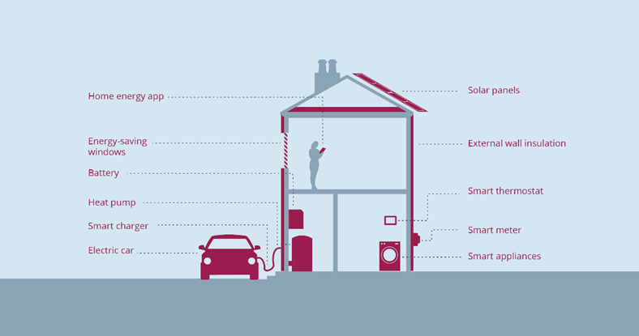
Changes to the home

Slide 5
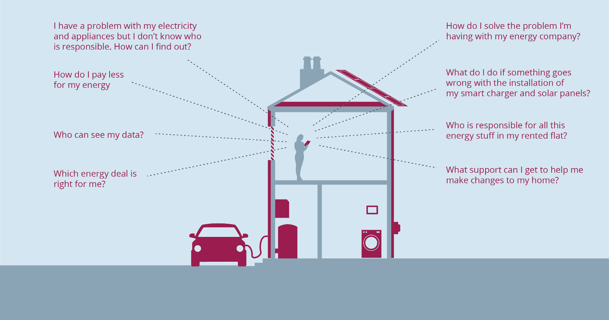
Future advice needs

Slide 6
Why is it important to be fair?
How do we pay for the changes?
Can everyone choose ‘stuff’ in the same way?
More choice and tailored offers will be good for lots of people
For others it will be harder/ complicated to work out what the best option is
A fair energy market should
  Make sure everybody can access products and services
  There is a range of choices for all people/homes
  People aren’t penalised for choosing not to get involved
Notes:
We need to think about fairness when we think about two things - how the changes are paid for and everybody chooses stuff for their homes.
How we pay for the changes is a huge question. There are two main aspects to this question
There is one aspect which is about how we can fairly pay for the energy changes that lots of people benefit from – things like improving the pipes and wires or making the grid smart.
For example if house number 1 gets an electric car there is little pressure on the local electricity distribution network. If houses 2 and 3 get one, and house 4 and 5 get a hot tub the network might still be fine. But by the time houses 8 and 9 get a smart charger for their electric car or a hot tub then the local grid will need reinforcing. That cost goes on everybody's bill. Is it ok for everyone on the street to pay? Even if they didn’t cause it and they don’t feel the direct benefit from the extra electricity capacity? How about the person who lives at number 12, who is bed bound, on a very low income and has high energy bills because they are at home a lot and need to keep warm but also live in a house that is very inefficient and leaks energy – and the landlord won’t invest in insulation?
The other aspect is about how people can get the best deal and the right products and services for them in their homes. We know that more choice and tailored options will be good for lots of people
For others it will be harder and more complicated to work out what the best option is for them. We expect homes in the future to have different appliances and ‘energy stuff’ in them. Will people who can’t or choose not to use these things end up paying more? Consumer protections all help to support people as they make these sorts of decisions.
Right now if you shop around to ‘switch energy supplier’ you can stand to save a lot of money, compared to someone who doesn’t. The government put in place an ‘energy price cap’ so that if you don’t change energy suppliers there is a maximum amount you can be charged, regardless of who your supplier is. As we try to reach net zero emissions, there are also questions about how to help people to pay for the changes – this will be different depending on what your home is like, how much work you’ll need to do, how you live in it (i.e. if you rent or own it), what you can afford etc.

Slide 7
What happens at the moment
Pay for change through bills or taxes?
Consumer protections are not straightforward
  There are at least 4 codes to protect people and promote household renewables
  There are numerous other rules structure to support people and make companies behave in certain ways toward their customers
  These do not give all people the same protections and support (for example if you are on a heat network)
  Hard for people to work out where to turn for help
Notes:
At the moment, most of the costs of the UK’s existing efforts to decarbonise are paid for through people’s bills, not taxes.
For example, electricity bill payers currently contribute about £7 billion a year towards the roll-out of low-carbon power stations. This is expected to increase to around £12 billion a year by 2030.
Consumers also pay for a range of other social and environmental policies through their bills, such as energy efficiency, financial assistance to vulnerable consumers, and the roll-out of smart metering.
By choosing to pay for these policies in this way, the costs disproportionately fall on the poorest in society.
(People who can manage their energy bills by using less, making their homes more efficient and taking advantage of things like smart products etc pay less then people who have no choice but to use more energy in their homes and have the highest bills but are not necessarily the people who are best able to afford to fund these changes.)
It is accepted that there will be more costs as we change things to meet net zero – in our view the current system is not fair.
Todays protections have been developed over time and we think they need an overhaul.
4 codes (recc, heis, ggf and trustmark) – that’s too many. People should have a clear understanding of what to expect when energy products or services are installed in their home. There are too many codes. We need one, easy to understand system to protect and cover all low carbon technologies in the home
Lots of other protections I won’t list them all but some examples include
Social obligations which exist to support people in vulnerable circumstances (for example if you’re in debt your energy supplier has to consider what you can afford etc when agreeing a repayment plan) but they only apply to licenced energy suppliers. Right now these riles don’t apply to all companies that provide heat for example, We think people should have the same level of protection regardless of which energy products and services they use.
Guaranteed Standards of service from energy network and supply companies – these exist to ensure people get good customer service Guaranteed standards only currently apply to licensed companies. These standards need to move with the times and represent 21st century customer service. We think that when companies don’t meet guaranteed minimum standards they should all pay compensation automatically without the consumer having to claim it.
Independent consumer advice, alternative dispute resolution – for example an ombudsman - and additional support for consumers in vulnerable circumstances. To ensure consumers have advice and support when engaging with the energy market Consumers need to be able to access the same support, regardless of what energy products and services they use.

Slide 8
What needs to happen next?
Costs –should some people not pay toward decarbonisation or pay less?
Put people at the heart of net zero policies
  Heat policy roadmap - governments plans should include a programme of information and support. To help people make decisions and also how to pay for the changes.
  Clear information – New rules to make sure businesses make information accessible and easy to understand
  Net zero regulation challenge – these new things will be confusing. Government bodies have to work together to make it easier for people to understand and get any issues resolved
Notes:
Costs – its difficult and you have heard from lots of speakers about this conundrum. One way could be to think about whether some people should not pay toward decarbonisation – or pay less. That’s something I will leave for you to discuss.
We want government to put consumers at the heart of net-zero policies
There are major changes coming - changes to the way we heat our homes/switching to EVs - people need to understand why these changes are coming, they’ll need information and support to help make them and they’ll need somewhere to turn when things go wrong.
Without these things public support could be lost and without public buy-in it will be impossible to achieve net zero.
People support net zero / but there is a gap in public understanding
82% of people support the public’s goal to achieve net zero
Only just over a third (38%) are aware they need to change the way their home is heated. The Committee on Climate Change believes 90% of homes need to install low-carbon heating systems for the UK to meet its net-zero goal by 2050.
Less than half of UK adults (44%) realised they will have to switch to an electric car.
But most people are concerned about costs and the inconvenience of making these changes.
There are major changes coming
29 million homes will need their heating system replaced with low-carbon alternatives - a monumental once-in-a-lifetime challenge
By 2040 all new vehicles will be effectively zero-emissions - requiring major upgrades to national energy infrastructure which will be paid for by consumers through their bills
New technologies and services in people’s homes like smart thermostats, electric car chargers and home battery storage will become widespread - changing the way we all use energy.
Concrete steps to put consumers at the heart of net zero?
Heat policy roadmap - the government’s forthcoming heat policy roadmap must include specific consumer protections and a programme of support for people to adopt low-carbon heating systems
Clear information - to give consumers the confidence to engage with (and change) the way they use energy, companies providing energy products, services or supply must make information about products and services transparent and accessible
Net zero regulation challenge - government and regulators working to make sure that consumer protections can adapt to a changing market.
How is it that the government is potentially fatally undermining its ability to achieve net zero?
We need to be clear there isn’t a failure of government policy. What we’re saying is that if you don’t put people at the heart of the process - give them clear info, help and support to make change and somewhere to turn when things go wrong - the public goodwill that’s there could be lost. And if the public don’t support the process then we won’t be able to make these huge scale changes and meet our net zero targets.
Why don’t people know about the changes that are coming?
There has yet to be a programme of public engagement on this. But we’re very much at the start of this process - there are 30 years to achieve this.
But as we outline in the report it will be critical to put consumers at the heart of the process. Because if people don’t understand why these changes are coming, don’t have information and support to help make them and or somewhere to turn when things go wrong - we could lose public buy-in for the changes that are need and without it we won’t be able to achieve net zero.
What are people confused about?
It’s not a case of being confused, but it’s about the potential changes not having been communicated. And that’s not necessarily a problem right now because we’re at the start of the process. But as the government develops its plans to get us to net zero consumers must be at the heart of the process.

