Slide 1
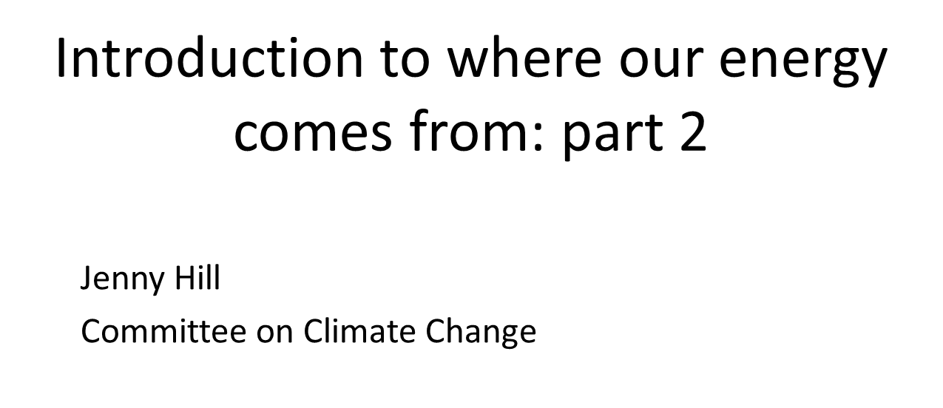
www.theccc.org.uk | @theCCCuk
@Jenny_C_Hill
Notes:
Jim’s covered the energy system as a whole, and in particular, electricity.
I’m now going to cover alternatives to fossil fuels like bioenergy which comes from plants - and manufactured fuels like hydrogen.

Slide 2
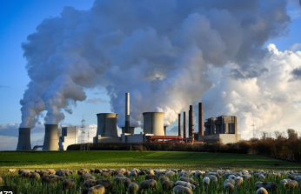








Quick recap - What is net zero
Carbon Capture and Storage
Notes:
As we heard in weekend 1, net zero means a cutting greenhouse gases as much as possible (eg from burning coal, oil and gas) – so firstly you reduce the emissions going into the atmosphere in the first police and then, secondly, you balance off what's left having done that.
Chris mentioned briefly that there are two main ways of doing that – planting trees is one because plants remove carbon from the atmosphere and store it long term.
On the other hand you have a set of technological approaches which are pretty expensive overall. So Chris mentioned direct air capture – sucking carbon out of the air and then storing it long term.
You’ll also hear people talking about carbon capture and storage (CCS in shorthand). This is when you remove the CO2 from fossil fuels (before or after they are burnt). And you can do the same thing with energy from plants (‘bioenergy’) – remove the carbon either before or after you use the plants for energy.
I want you to bear this is mind because it’s going to come up a few times when we look at these alternative fuels.

Slide 3

Low-carbon alternative fuels (?)
Hydrogen
2. Bioenergy – energy from plants
3. Synthetic fuels
Not necessarily low-carbon
Notes:
I’m going to whizz through these three sources of alternative energy […] I’m going to focus mainly on the first two for reasons I’ll come to.
You’ll notice the question mark in the title there. That’s a pretty important question mark. It’s there because these sources are not necessarily low-carbon – there is a lot of controversy, particularly around bioenergy which is a real hot potato.
The other reason there is a question mark is that a lot of the ways in which people are talking about using these are not yet fully developed, so there is naturally some scepticism about the role they can play, and a real genuine concern about relying on them too much (and not doing the basic stuff like insulating leaky buildings properly).

Slide 4









How UK net-zero could be achieved
Energy supply
Energy use
Land use
Notes:
Again, quick recap – why do we look at alternative fuels?
2 reasons - firstly, electricity will only get you so far – so you can use it for cars and vans, to heat homes, and in some bits of industry
If you have a fuel like hydrogen (and crucially, if you can make enough of it in a way which doesn’t release carbon in to the a), you can use that to make very high temperature heat in industry, or for heavy transport like ships and trucks.
The second reason there is a lot of focus on ways in which we can actually remove emissions from the atmosphere – and if you combine bioenergy with carbon capture, there is potentially some scope to do this – but critically, only if you are continually replanting/regrowing the crops and trees so that they continue to suck up carbon from the atmosphere.

Slide 5
How UK net-zero could be achieved
Energy supply
Energy use
Land use
H₂
H₂
H₂
H₂
H₂
H₂
H₂
H₂
H₂
H₂
Notes:
Again, quick recap – why do we look at alternative fuels?
2 reasons - firstly, electricity will only get you so far – so you can use it for cars and vans, to heat homes, and in some bits of industry
If you have a fuel like hydrogen (and crucially, if you can make enough of it in a way which doesn’t release carbon in to the a), you can use that to make very high temperature heat in industry, or for heavy transport like ships and trucks.
The second reason there is a lot of focus on ways in which we can actually remove emissions from the atmosphere – and if you combine bioenergy with carbon capture, there is potentially some scope to do this – but critically, only if you are continually replanting/regrowing the crops and trees so that they continue to suck up carbon from the atmosphere.

Slide 6



How UK net-zero could be achieved
Energy supply
Energy use
Land use
H₂
H₂
H₂
H₂
H₂
H₂
H₂
H₂
H₂
H₂
CO₂ storage
Notes:
Again, quick recap – why do we look at alternative fuels?
2 reasons - firstly, electricity will only get you so far – so you can use it for cars and vans, to heat homes, and in some bits of industry
If you have a fuel like hydrogen (and crucially, if you can make enough of it in a way which doesn’t release carbon in to the a), you can use that to make very high temperature heat in industry, or for heavy transport like ships and trucks.
The second reason there is a lot of focus on ways in which we can actually remove emissions from the atmosphere – and if you combine bioenergy with carbon capture, there is potentially some scope to do this – but critically, only if you are continually replanting/regrowing the crops and trees so that they continue to suck up carbon from the atmosphere.

Slide 7





How UK net-zero could be achieved
Energy supply
Energy use
Land use
H₂
H₂
H₂
H₂
H₂
H₂
H₂
H₂
H₂
H₂
CO₂ storage
Notes:
Again, quick recap – why do we look at alternative fuels?
2 reasons - firstly, electricity will only get you so far – so you can use it for cars and vans, to heat homes, and in some bits of industry
If you have a fuel like hydrogen (and crucially, if you can make enough of it in a way which doesn’t release carbon in to the a), you can use that to make very high temperature heat in industry, or for heavy transport like ships and trucks.
The second reason there is a lot of focus on ways in which we can actually remove emissions from the atmosphere – and if you combine bioenergy with carbon capture, there is potentially some scope to do this – but critically, only if you are continually replanting/regrowing the crops and trees so that they continue to suck up carbon from the atmosphere.

Slide 8
Zero-carbon hydrogen can be produced two main ways:
Electricity + water
“green hydrogen”
££££
Fuel + Carbon Capture and Storage
“blue hydrogen”
££
Weekend 2. We’ll hear about hydrogen in the two sessions –
How we travel & In the Home
Notes:
Also relevant to what we buy (can be used to make products using much less carbon)

Slide 9
Bioenergy is used for electricity, heating, cooking and transport
Can be solid (wood, pellets), liquid (e.g. biofuels made from crops) or gas (e.g. methane from food waste, or hydrogen)
Limited supply globally – needs to be used as efficiently as possible
Can be used to remove carbon from the atmosphere
Notes:
This is a big topic which you’ll hear a lot more about on weekend 4.
Only covering here at a v high level!
Lots of different uses […] Largest use internationally is still burning wood for cooking and heating, mainly in developing countries
In the UK, we use it mainly to make electricity – that includes a significant amount of wood pellets which import – the UK is in fact the second largest importer in the world, after China – just over half in total. Next biggest use is to heat buildings.
Limited supply globally – so if you were to try and use it for air travel, that could easily use up – that is dwarfed by the amount that you would need if you we were to stop using plastics from fossil fuels and try and replace them all with plastics made from plants.
Finally, a lot of interest in the potential role bioenergy could play if combined with carbon capture and storage for meeting net zero – but no one is currently doing that at scale yet. We will come back to this in weekend 4 as it’s an important question.

Slide 10
Bioenergy is controversial – can we be confident in savings? No other impacts?
Huge possible range in terms of the emissions – so it must be sustainable (e.g. waste-- or replanting if crop)
Historical issues with driving up food prices – particularly where using crops to produce transport fuels
You have to have the right sustainable practices and systems in place - this may be easier with UK bioenergy
Notes:
On the one hand, in the absolute worst case can be worse than using coal to produce energy (e.g. …)
Sustainable – [example of to produce hydrogen (can even combine with CCS!)]
Other impacts can include air pollution (particularly from burning wood for heat).
So this means [box]
This weekend - we will hear about bioenergy mainly in the land use, food and farming session, but also in Transport (liquid biofuels) and In the Home (heating)

Slide 11

Synthetic fuels could be used in parts of the energy system where it is hard to cut emissions – but they are expensive
Hydrogen
CO2 (e.g. from direct air capture)
Synthetic fuels
+
=
We will hear about these briefly in the Transport session.
Notes:
The last thing I’m going to cover is…
These are mainly being considered by the aviation industry at the moment – particularly in the case of long-haul flights which aren’t really suitable to switch to electric planes.
And as we’ve seen, you probably don’t have enough sustainable supply of biofuels (and you might well want to use the bioenergy for other things like removing emissions from the atmosphere…)
How are they made? First things first – worth saying that these are currently at an early innovation phase.
- Synthetic fuels would need a source of captured carbon dioxide as an input (e.g. from direct air capture)
You then combine this with (low-carbon) hydrogen to make fuel.
- However, at the point of capturing the carbon dioxide you have another choice, which is to store it rather than process into fuel
We think the additional cost of turning the carbon dioxide into a synthetic fuel is ~5x more than storing it, given the additional electricity generation capacity and processing steps required
So there’s a decision for aviation industry as to whether they want to pursue it given it is expensive.
Current CCC advice is that it shouldn’t be a priority for Gvmt support

Slide 12
www.theccc.org.uk | @theCCCuk
@Jenny_C_Hill

