Slide 1

Introduction to surface travel
Professor Jillian Anable
University of Leeds
Climate Assembly UK – Weekend 2
Birmingham, 9th February 2020
Contact: J.L.Anable@leeds.ac.uk
www.creds.ac.uk

Slide 2
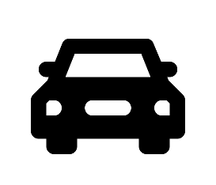

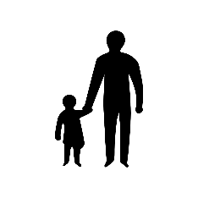









What is ‘surface’ travel?
Passenger transport
Private transport
Public transport
‘Active’ transport
Other
‘Virtual’ transport
Freight transport
Notes:
Picture credits
Car Icon: transport by Fauzan Adiima from the Noun Project
Bike icon: transport by Visual Glow from the Noun Project
Train by Lee Mette from the Noun Project
Bus by Wilson Joseph from the Noun Project
Scooter by Hea Poh Lin from the Noun Project
Motorcycle by fms_design from the Noun Project
Lorry by Georgiana Ionescu from the Noun Project
Van by Darren Camilleri from the Noun Project
Taxi Car by Maxim Kulikov from the Noun Project
PC by Yeoul Kwon from the Noun Project
smart-phone by BomSymbols from the Noun Project

Slide 3
What proportion of Greenhouse Gases (GHGs) does surface passenger travel account for?
All transport: 33% of UK GHGs
All surface transport: 23% of GHGs
Surface passenger transport: 15% of GHGs
Notes:
BEIS (2019) Final UK greenhouse gas emissions national statistics 1990-2017.
Surface passenger = All cars, buses, rail and other. But it does not include vans.

Slide 4
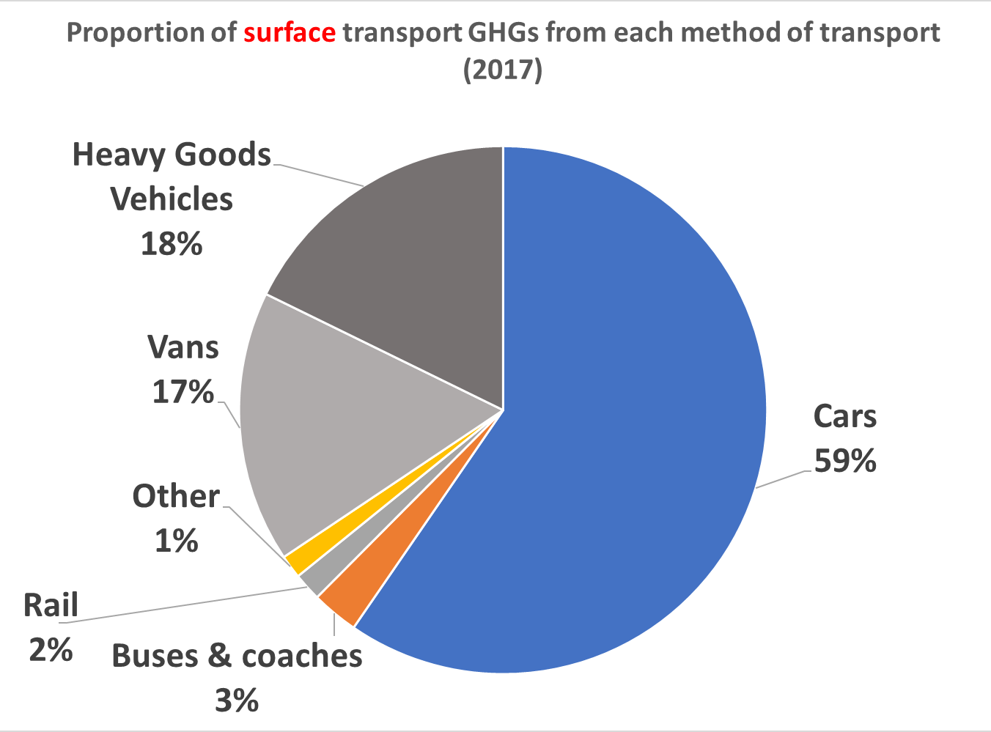
Cars are responsible for the greatest share of surface Greenhouse Gases
Cars = 59%
Public transport = 5%

Slide 5
Frequency and distance of trips are important
% trips
% distance
Only 3% of car trips are over 50 miles, but they account for 30% of distance
Just over a quarter of trips are on foot, but almost all are less than 1 mile
Notes:
Source: National Travel Survey

Slide 6
Cars are used very inefficiently
Most cars are stationary for 98% of the time
Every day, one third of cars do not move at all
62% of car trips are done with only the driver
Approx. 36 million empty car seats commute to and from work! = Lots of scope for car sharing & ride sharing
Transport is the highest part of household outgoings: 14% of weekly household expenditure on average
But remember: 24% of households do NOT have a car

Slide 7
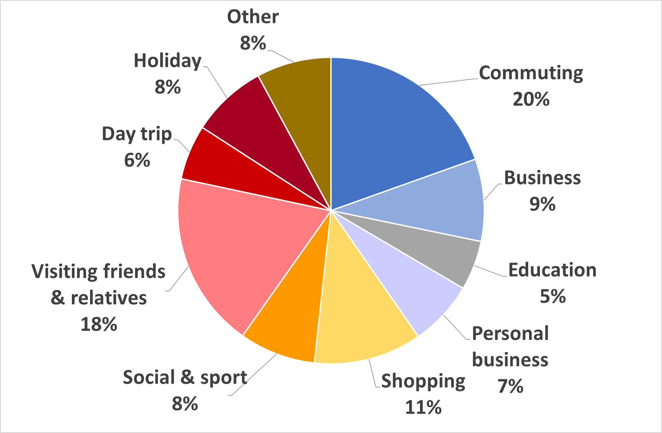
Leisure activities are responsible for the majority of distance travelled, not commuting or school trips
Proportion of surface passenger distance undertaken by activity (2018)
Notes:
Sources: NTS (England) 2018 *surface modes only

Slide 8
How could emissions be reduced from travel?
Reducing Greenhouse Gases
AVOID
SHIFT
IMPROVE
Organise services so that distances that people need to travel can be reduced
Moving journeys onto the most efficient/lowest carbon forms of travel
Making the emissions performance of vehicles low or zero carbon
EXAMPLES:
Land use planning (e.g. building houses with public transport)
Putting services back into local (especially rural) areas
Encouraging use of the most local services
Videoconferencing
Teleconferencing
EXAMPLES:
Bus priority lanes, rail lines, cycle lanes and pedestrianised areas
Subsidisation of services incl. flexible ‘on demand’ services
Simplifying/ lowering ticket prices
Charging for car parking
Closing certain roads to cars
Charging for road use
Not building more roads
Car sharing / ride sharing
EXAMPLES:
Electric or hydrogen cars, buses, trains
Low carbon fuels (e.g. biofuels)
More efficient engines
Phasing out the least efficient vehicles
Lowering and enforcing speed limits

Slide 9
What type of policy interventions could be used to achieve avoiding, shifting and improving?
 | Examples
Informing/ Engaging | Public information campaign
Supporting/ subsidising | Subsidising services Building rail lines, cycle and bus lanes, pedestrianisation Providing free or cheap transport passes
Pricing / taxing | Fuel taxes Road pricing Grants (e.g. for electric cars or bikes) Scrappage scheme
Regulating | Banning certain vehicles in certain places and times Not allowing some vehicles to be sold
Notes:
Not allowing certain vehicles in certain places at certain times
Not allowing certain vehicles to be sold
Fixing public transport fares
Mandating the use of certain technologies (eg electric buses)

Slide 10
Why else might we want to do these things?
*The emissions responsible for climate change and those responsible for air pollution are different. CO₂ is not a local air pollutant. Nitrogen oxides and particulates are the big ‘local’ pollutants from transport. But – good news - the solutions generally overlap
Cleaner air *
Less noise
Less congestion
Greater access to jobs
Reduced social isolation
Better road safety
More physical activity/ less obesity
Improved mental health
Nicer places to live, work, rest and play

Slide 11
Panel 1: Surface travel
What could be done to reduce emissions?
Reducing emissions from cars
Alternatives to cars
Fairness
How can we get there?
How to make change happen: view 1
How to make change happen: view 2

