Slide 1
How to reduce emissions from cars
Dr Ellie Davies
Committee on Climate Change

Slide 2





Car technology options
 | Petrol or diesel | Hybrid | Plug-in hybrid | Fully electric | Hydrogen
Refuelling |  |  | +
Overall % emissions reductions | Can be improved, Can use limited biofuels
50-55%
70-80%
100%
100%
Diesel can mean bad air quality. Tyre & brake wear still issues.
Notes:
Petrol/Diesel
Improvements (e.g. engines, making cars lighter, tyres) can be made
Smaller cars are ~40% more efficient than larger cars
Can switch to hybrids e.g. Toyota Prius
Emissions reductions limited to ~50-55%
Plug-in hybrid
Have a small battery (~30 miles) & run on petrol or diesel the rest of the time
Average daily mileage can be done in electric mode
Higher emissions if not charged regularly
Some evidence that people are not charging them regularly
Battery
Even including manufacturing emissions and todays grid electricity - can save 60-70% compared to a petrol/diesel car
Talk about air quality from brakes and tyres
Air quality
Tailpipe emissions from petrol/diesel cars, hybrids and PHEVs when running in that mode
Brake and tyre emissions from BEVs

Slide 3
Relative costs of cars
Medium size car in 2030
Electric cars are more expensive than petrol and diesel vehicles but prices falling
Running costs much lower than petrol and diesel
By 2030, fully electric cars will be cheaper

Slide 4
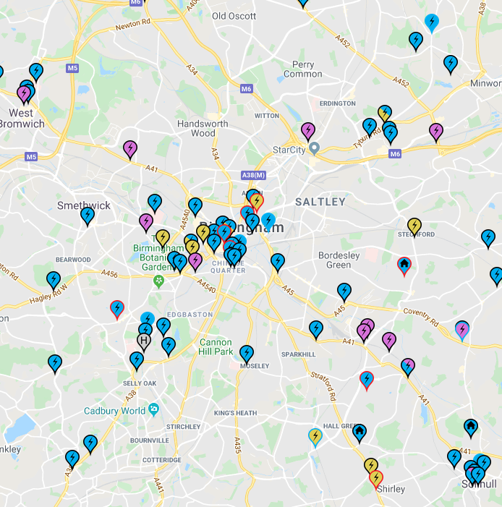
Recharging fully electric vehicles
Most new models out this year have 150+ miles range before needing recharging.
Can be refuelled when parked overnight
Newest type of chargers can give ~100 miles in 10-15 minutes for longer journeys (e.g. at motorway service stations).
Zap-map.com

Slide 5
Sales of zero emission vehicles
Norway - March and September 2019:
Battery electric more than 50% new car sales
Manufacturers bringing out electric vehicles in 2020:
Vauxhall, Skoda, Kia, Mini, Peugeot, Honda, Volkswagen
2019

Slide 6
Ridesharing and driverless cars
Over a third of cars are over 10 years old
Switching to new types of cars must happen soon.
Ridesharing can reduce number of journeys taken → reducing emissions.
Driverless cars could help people share vehicles – but not available for ~10 years
Need to have reduced emissions from new cars significantly before then.

