Slide 1


Road Pricing for Prosperity
Climate Change Citizen Assembly

Slide 2
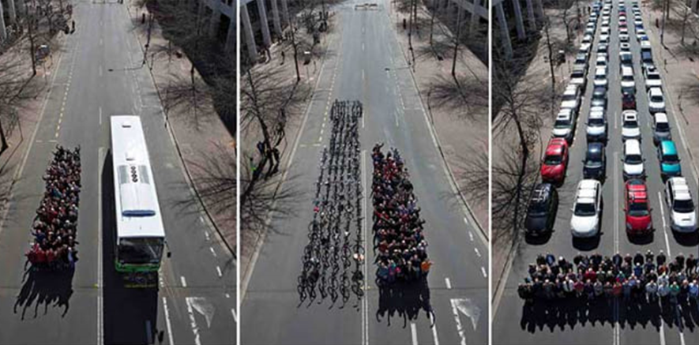



How do you allocate scarce capacity

Slide 3
What we are proposing
A single charging system comprising three elements:
Congestion charge
Environmental charge
Maintenance charge
All charges are based on distance driven
Charges are set by an independent body
Drivers will be able to drive now and be billed monthly or can book a journey via an App and be guaranteed a journey time or receive compensation if delayed

Slide 4
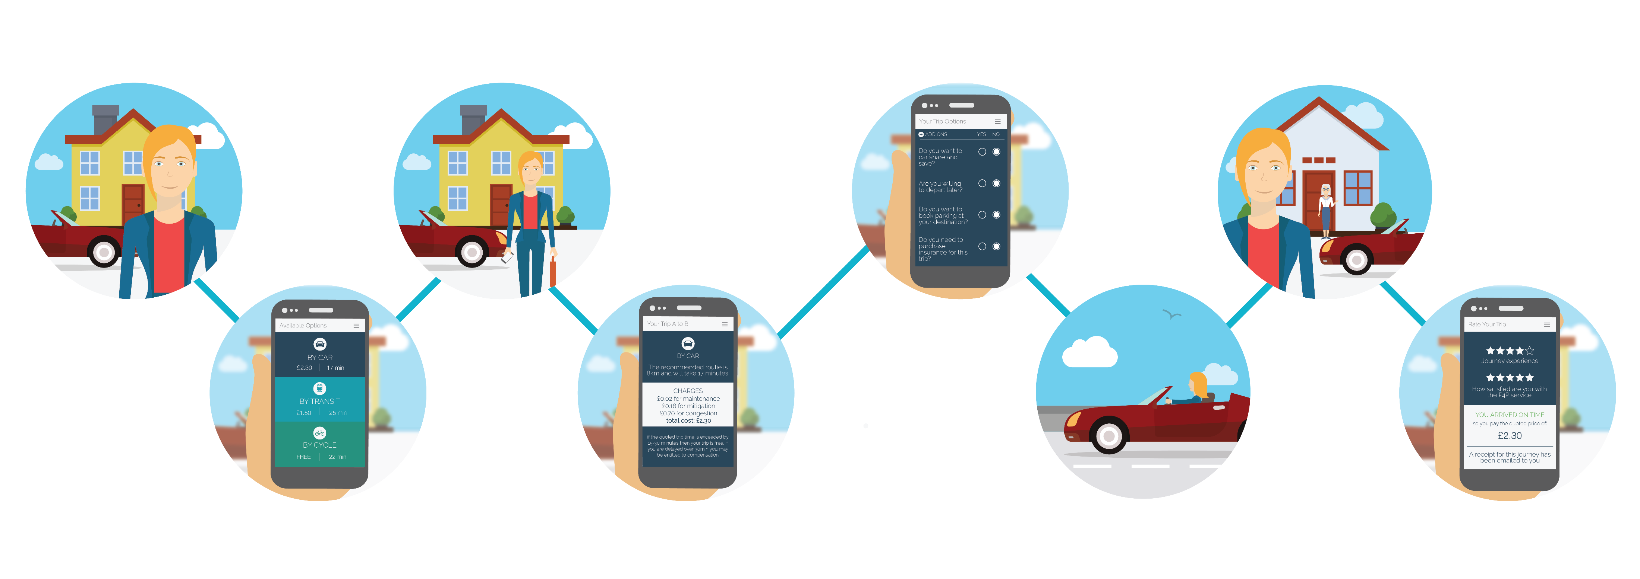
User’s perspective
I need to check on elderly mum
I need to get there 6:30am and carry some stuff
CAR £2:30
Train £1:50
Cycle
Free

Slide 5
User’s perspective

Slide 6
General implementation issues
Will take a number of years to implement
“Black box” installed at MOT or already exists in modern cars to track vehicle
Privacy can be maintained via new technology and payments made anonymously.
There will be no central Government database of people’s journeys or data kept secure like tax records
All existing motoring taxes and tolls scrapped

Slide 7
Benefits of road pricing to people
£5947
-25%
£2974
£2041
£736
Currently
P4P
Financial Cost
Time Cost
I pay more but I know exactly what time I'm going to get home, my commute takes less time so I have more time to spend with the kids
I live in the countryside but work in a nearby town
I drive 12,000km for my commute in my economical car

Slide 8
Benefits of road pricing to people
£420
-36%
£420
£312
£50
Currently
P4P
Financial Cost
Time Cost
I am a pensioner living in a rural area and drive occasionally
I drive 3000km in my old, small car, mostly for going shopping
All the potholes have gone on our local roads and its costing me less to drive than before

Slide 9
Benefits of road pricing to the individual
Pricing will encourage drivers avoid congestion by re-routeing, re-timing or changing mode or destination.
Pricing encourages use of more environmentally friendly vehicles
Polluting and road-damaging freight vehicles will pay more but will benefit from more reliable and faster journeys
Majority of cleaner private cars will pay less.
A vehicle scrappage scheme could encourage replacement of older more polluting vehicles.
Enhance bus services to provide choice in advance of scheme commencing.
Those in rural areas, even though they drive more than average, will pay less than those in urban areas as there will be no congestion charge element.
The solution is compatible with future introduction of Connected and Autonomous Vehicles.

Slide 10
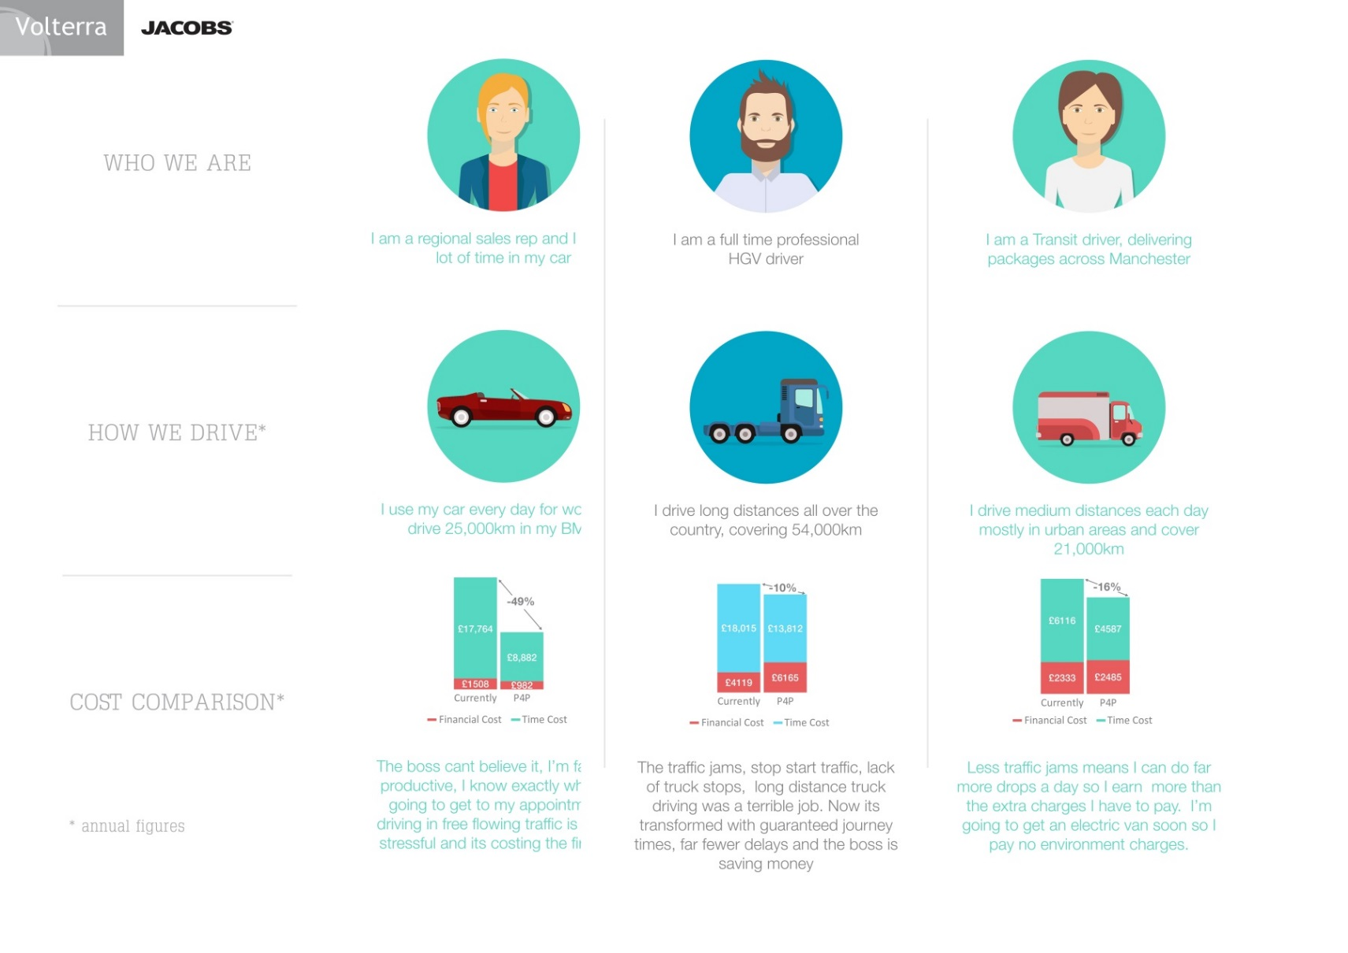
Benefits of road pricing to business
-36%
£18,015
£13,812
£4119
£6165
Currently
P4P
Financial Cost
Time Cost
Traffic jams, stop start traffic, lack of truck stops, long distance truck driving was a terrible job. Now its transformed with guaranteed journey times far fewer delays and the boss is saving money
I am a full-time HGV driver
I drive long distance all over the country , covering 54,000km

Slide 11
Benefits of road pricing to business
£6116
-16%
£4587
£2333
£2485
Currently
P4P
Financial Cost
Time Cost
Less traffic jams means I can do more drops a day so I earn more than the extra charges I have to pay. I'm going to get no environment charges
I am a transit driver, delivering packages across Manchester
I drive medium distances each day mostly in urban areas cover 21,000km

Slide 12
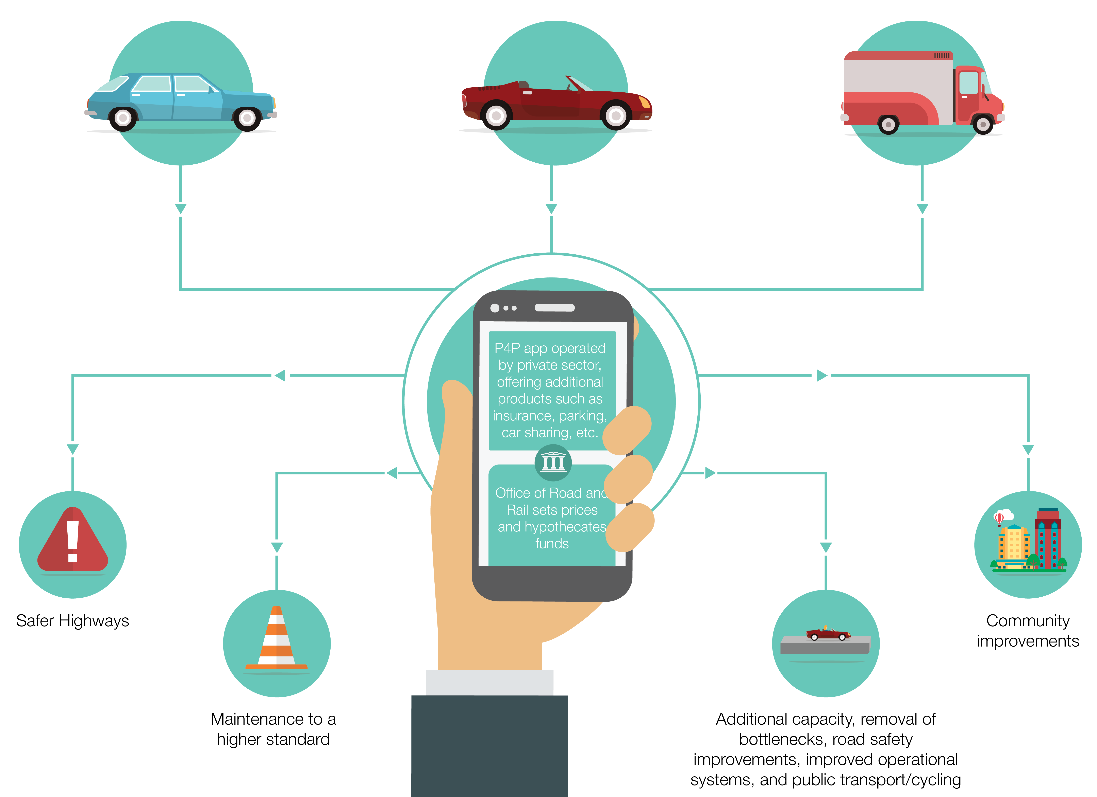
Where does the money go?

Slide 13






