Slide 1


Hydrogen & hybrid heating
Chris Clarke
February 2020

Slide 2
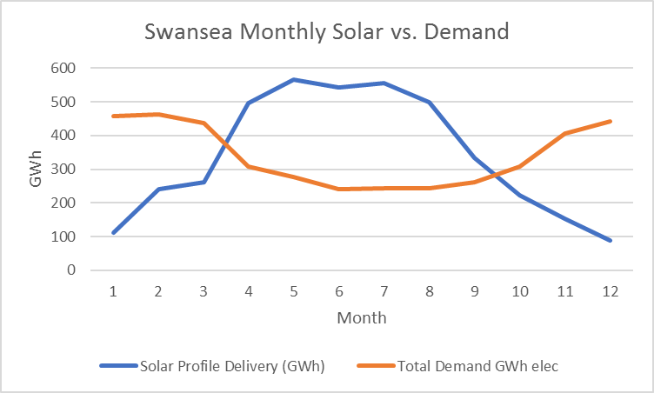
The challenge of heat – case study = Swansea
Demand for heat is very seasonal
Problem for renewable energy is meeting demand in the winter
Hydrogen is an alternative
Energy
Jan Month Dec

Slide 3
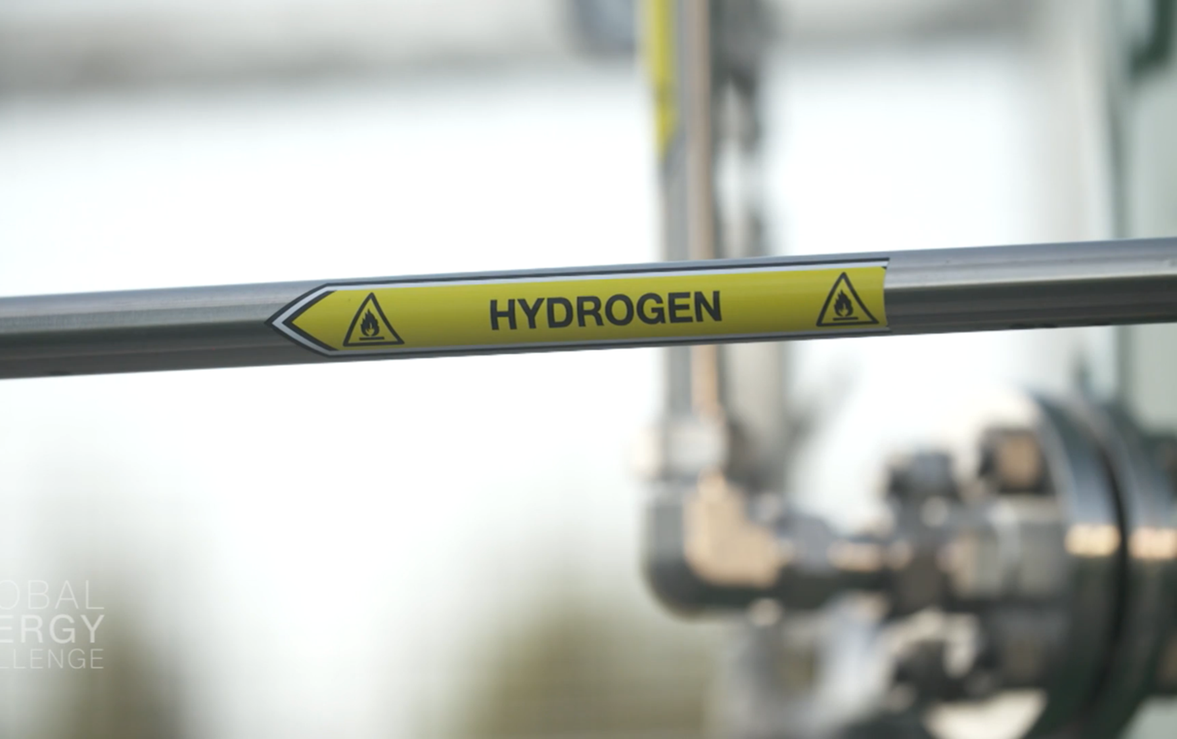

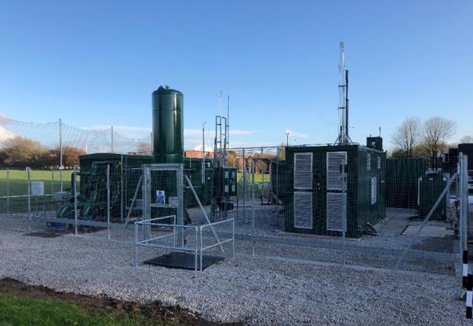
Hydrogen
Properties
  Gas you burn, just like natural gas
  But emits no carbon dioxide in use
  Was the main component of Town Gas
Production
  Made using a chemical process from methane
  This emits carbon dioxide which can be stored in old gas wells offshore
  Can be made from electricity – but currently more expensive
Purpose
  Can flow through existing gas pipe network
  Multiple Uses
  Can be stored in large quantities

Slide 4
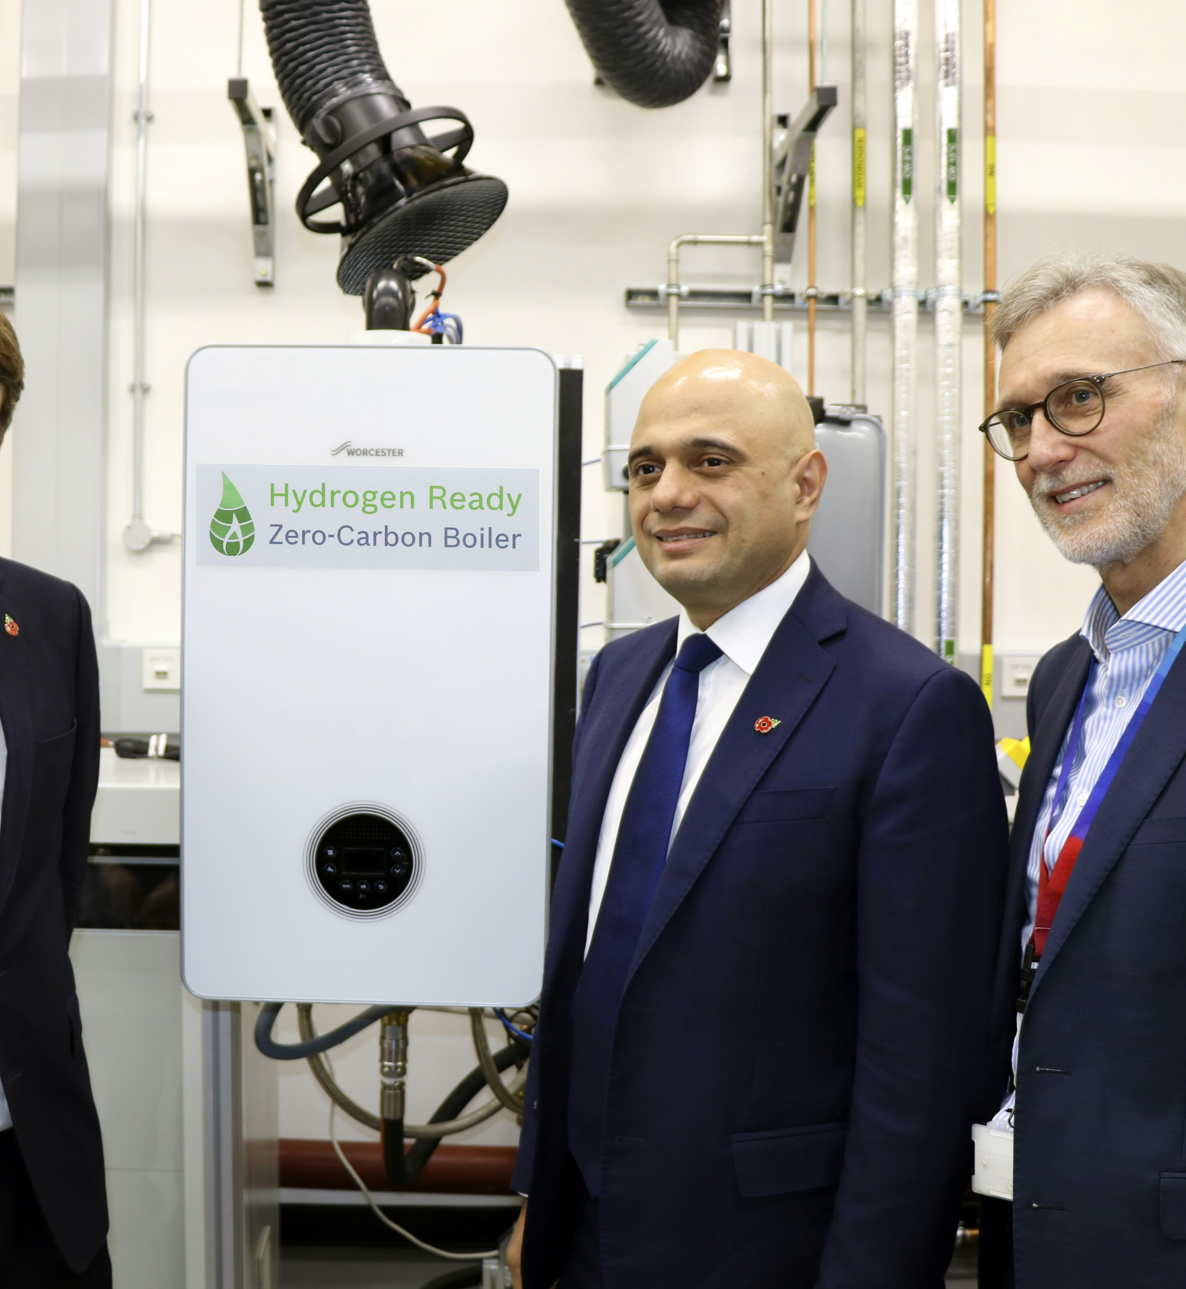
In the Home
Several manufactures have designed hydrogen ready boilers
Works in the same way as current gas boiler
January 2020 – Keele University started using hydrogen, blended with natural gas for homes and business
If all boilers sold were hydrogen ready the switch-over would be easy (like digital TV change)
Notes:
Sajid Javid

Slide 5
Benefits & Challenges of hydrogen
Benefits
Challenges
  Can be stored in large quantities for long periods
  Easy to transport in large volumes
  No need to ban boilers
  Least disruptive to consumers
  Maintains industrial use and UK jobs
  Carbon capture – not used in UK yet
  Production plants and storage – to be built
  Switching plan needed
  Non ready boilers and appliances would need converting
  Some have reservations about hydrogen
Notes:
Detailed plans have been made
Hydrogen could be available from 2025 starting in NW England/Scotland

Slide 6
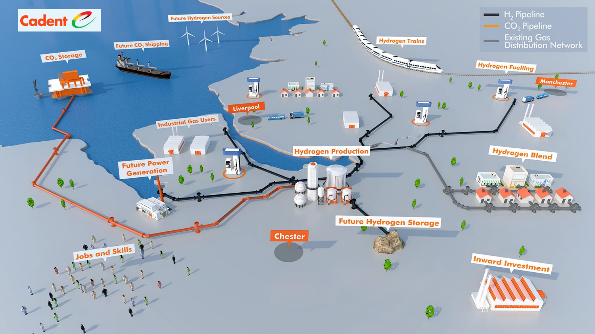
Detailed Design - 2025

Slide 7
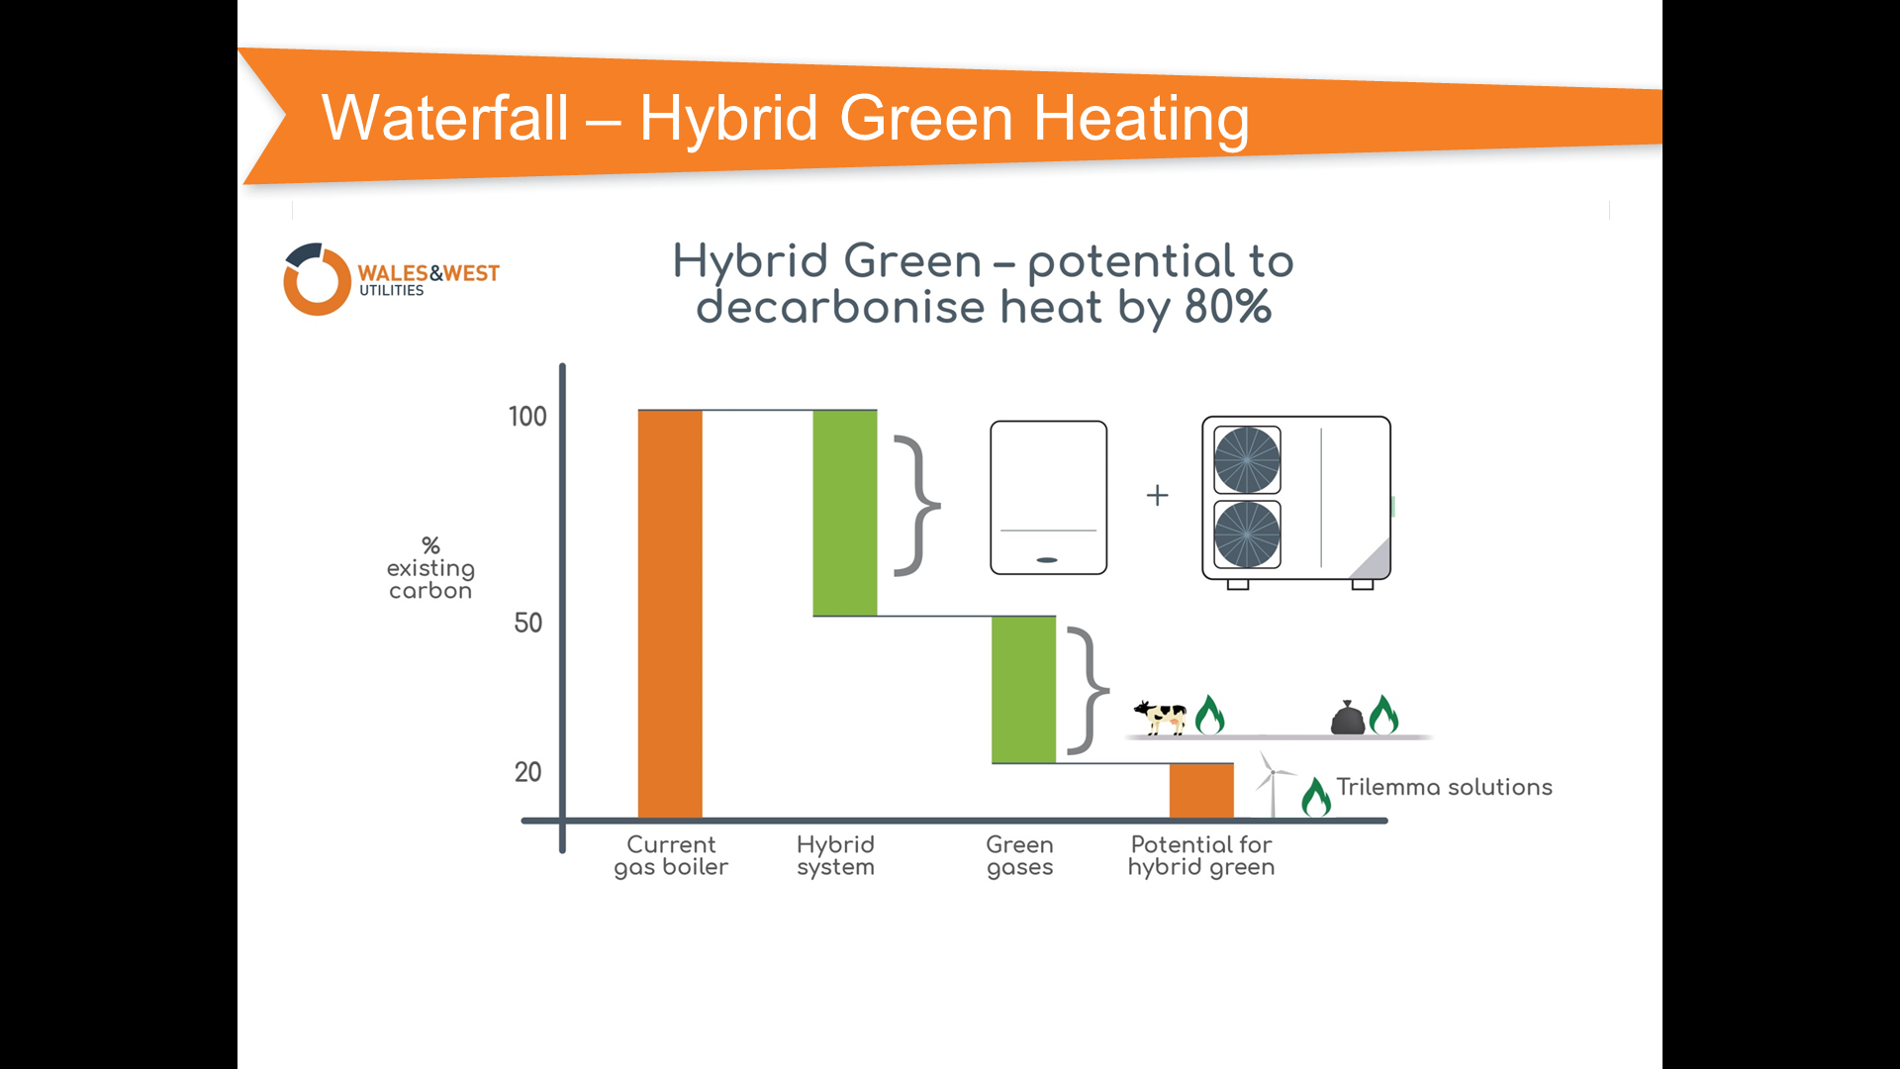






And hybrid heating – the best of both worlds?
Warm Home Guaranteed
+
same central heating system
add small heat pump
Uses renewable electricity when available
Uses green gas when electricity is not available
Lowest Cost  Least Disruption  Easiest Action  Earliest Carbon Reduction 

Slide 8


