Slide 1


Slide 2
Introducing yourselves
Your first name
Where you’re from
One thing you enjoyed or liked about the first weekend

Slide 4
Things to think about when listening
Alan Renwick
Constitution Unit, University College London

Slide 5
What kind of discussion are we aiming for?

Slide 6
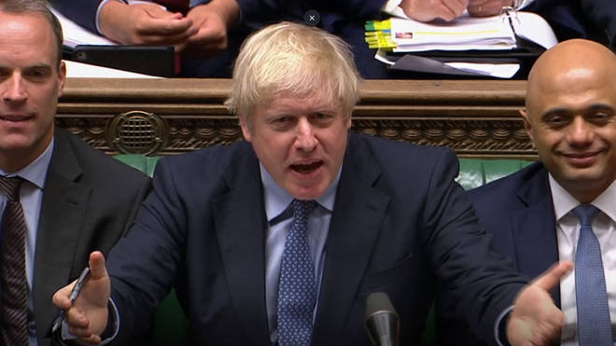
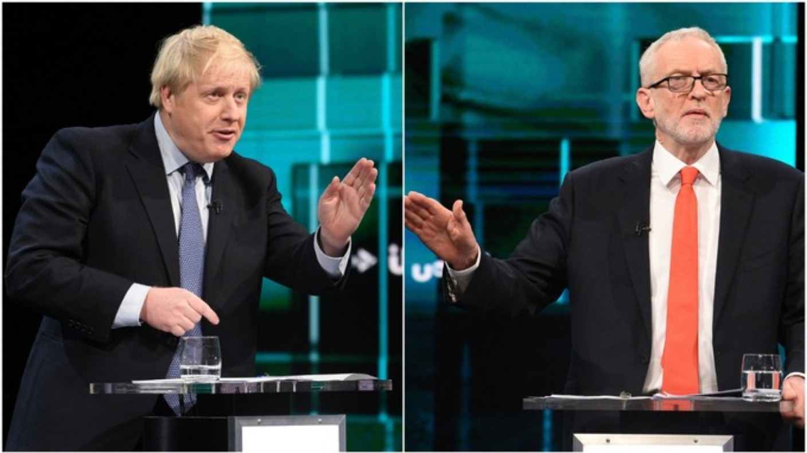
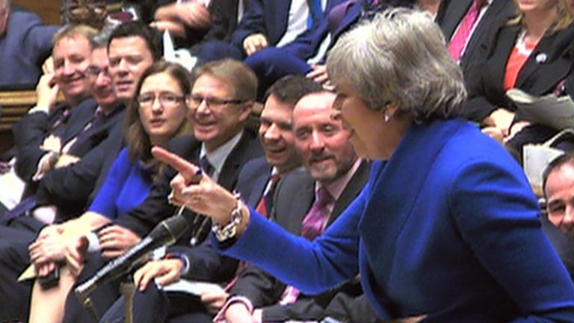
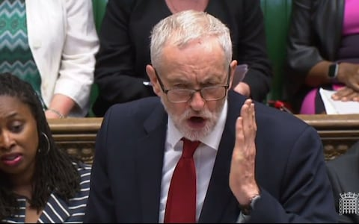
Debate

Slide 7
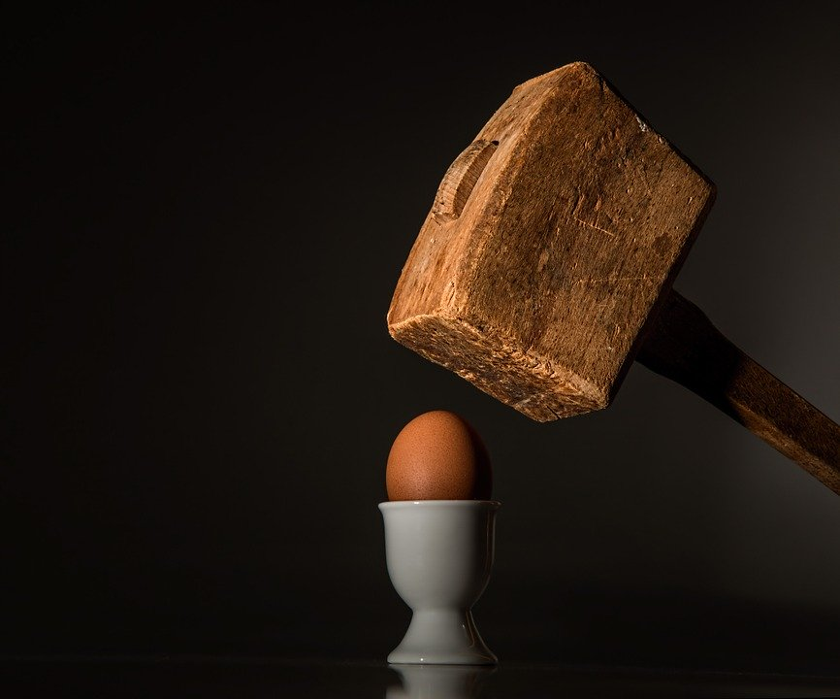
Debate
= de battere
= ‘to beat down’
Participants are on one side or the other
Their goal is to win the argument
Neither side is trying to learn from the other

Slide 8
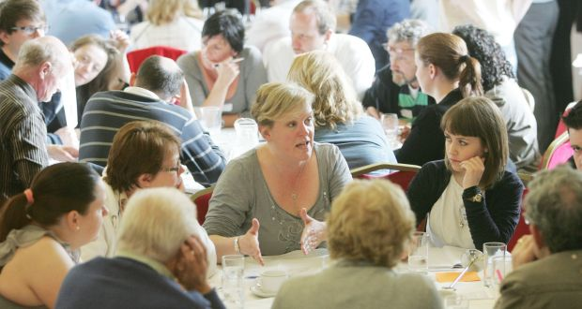
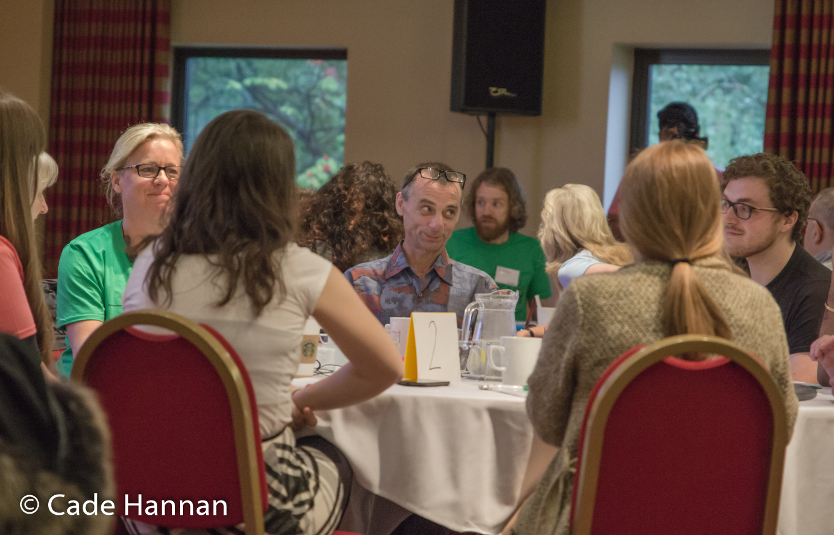
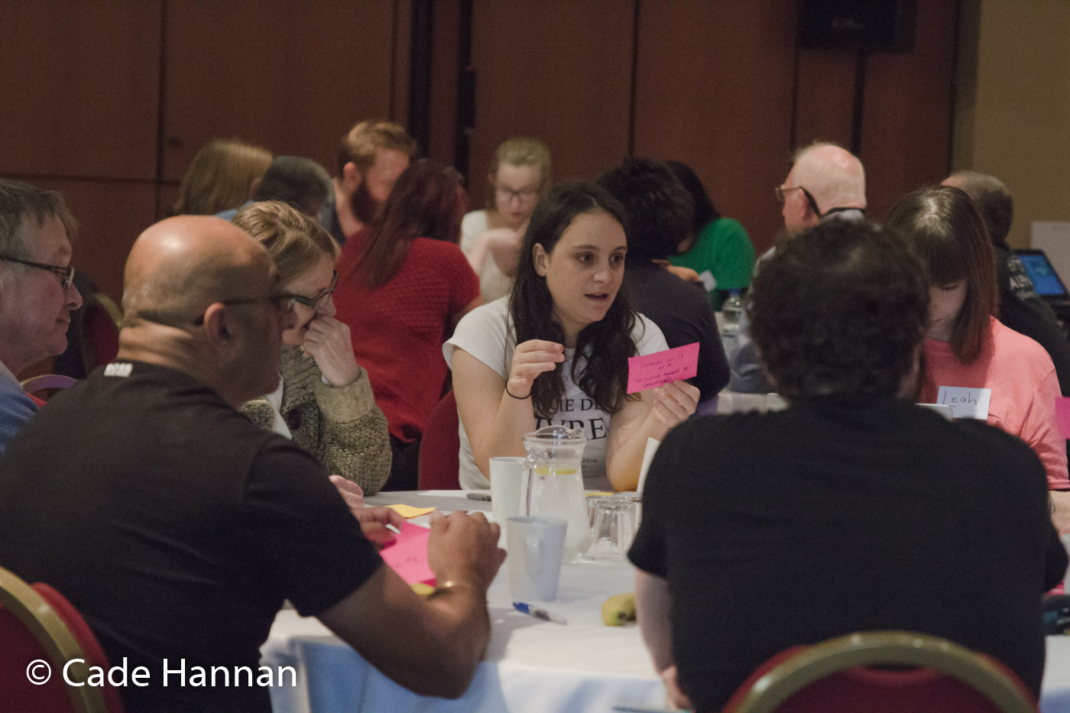
Debate
Deliberation
= de battere
= ‘to beat down’
Participants are on one side or the other
Their goal is to win the argument
Neither side is trying to learn from the other

Slide 9

Deliberation
from de libra
= ‘to weigh up’
Participants don’t have fixed views yet
Their goal is to come to a considered view
They are keen to learn from others

Slide 10
What does deliberating involve?

Slide 11
What does deliberating involve?
Reflecting on your own thoughts
Discussing with others
Listening to others
conversation guidelines
Reflecting again

Slide 12
Listening to whom?

Slide 13
Listening to whom?
advocates
scientists
each other
witnesses
stakeholders

Slide 14
How can we listen most effectively?

Slide 15
How can we listen most effectively?
by thinking about what speakers are saying
by being aware of how we are listening

Slide 16
Thinking about what speakers are saying
1. Are they backing up their claims with good evidence and arguments?
2. Why might someone take a different view?
3. When speakers disagree, why are they disagreeing?

Slide 17
Pitfalls in how we listen
(biases)

Slide 18
We’re better at listening to people who present well

Slide 19
We’re better at listening to people who we think are like us

Slide 20
We’re better at hearing things that fit with what we already think

Slide 21
Individual stories move us more than evidence about lots of nameless people

Slide 22
We're worried about being liked

Slide 23
We’re better at remembering the argument that we heard last

