Slide 1

Different practical approaches to cutting UK emissions to net zero
The different groups who need to act:
  central government and local government
  businesses and communities
  individuals
What government can do
  information and advice
  spending and investment
  taxes and subsidies
  regulations

Slide 2
1. The different groups
government (central & local)
businesses & communities
individuals

Slide 3
Example: city travel
charge cars to enter
good bus services
build cycle lanes
government (central & local)
walk more
cycle more
use public transport
bike hire
bus services
electric taxis
businesses & communities
individuals

Slide 4
2. What can government do?
There are lots of ways that government can help businesses, communities and individuals to get to net zero.
Information and advice
Spending and investment
Taxes and subsidies
Regulations

Slide 5
Information and advice
Offering information; suggesting how people can act differently
eg: advice on how to save energy in the home
Advantages: relatively cheap; doesn’t force anyone to act
Disadvantages: can be ignored; doesn’t make it easier to act unless there are other changes as well

Slide 6
Government spending & investment
Government spends public money (funded through taxes and borrowing)
eg: cycle paths; insulating homes
Advantages: government tackles the problem directly. It benefits everyone.
Disadvantages: Uses public money; might be unpopular.

Slide 7
Taxes and subsidies
Using the tax system to change prices.
eg: fuel tax; no road tax for electric vehicles.
Advantages: makes the zero-carbon alternative cheaper. Can raise money to spend on other things.
Disadvantages: Is it fair? What if there are no alternatives? Might be unpopular.

Slide 8
Regulations
Changing the law to ban the most high-carbon options.
eg: gas boilers; light bulbs.
Advantages: Simple and predictable. Applies the same to everyone (unlike taxes). Can be introduced gradually.
Disadvantages: Might affect businesses (especially if traded internationally); might be unpopular; has to be designed carefully.

Slide 9
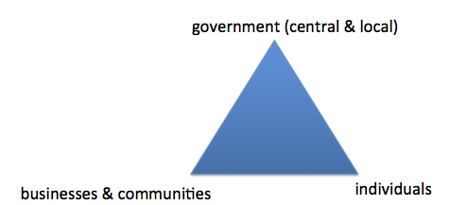
Conclusions
Needs action from all three groups
Government: combination of
Information and advice
Spending and investment
Taxes and subsidies
Regulations

