Slide 1
Co-benefits of action on climate for health
Modi Mwatsama, 24 January 2019

Slide 2
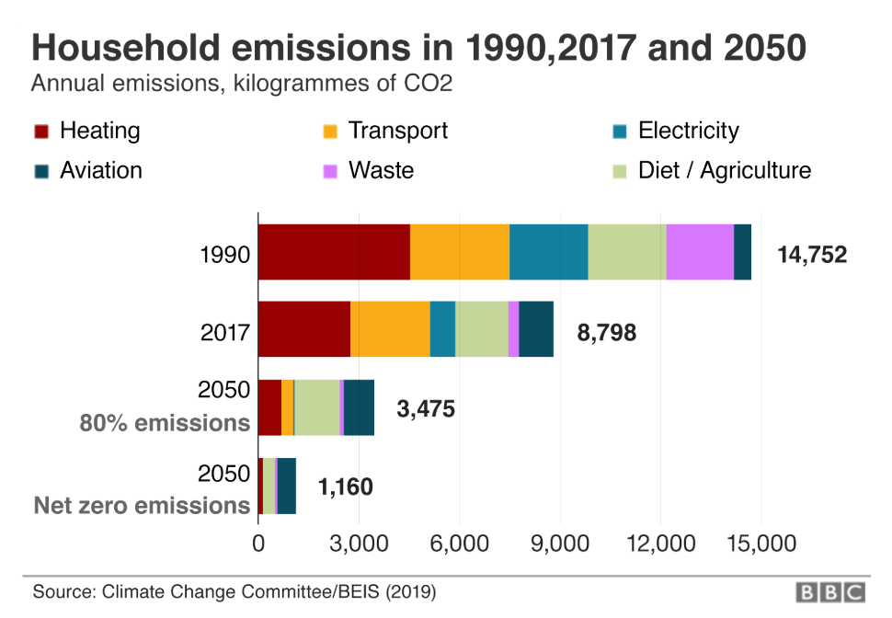
https://www.bbc.co.uk/news/science-environment-48122911

Slide 3
A
B
C
https://www.bbc.co.uk/news/science-environment-48122911
Notes:
Solid science: we have a good understanding of the problem
Solutions: current evidence points to some promising approaches but we don’t yet have all the answers
Climate change is too urgent to not start to do anything in the meantime
A key goal for everyone – government, industry, academia & research, civil society and individuals to start to take action and learn by doing – evaluate policies & interventions, see what’s working and what could be improved on.

Slide 4

Heating & housing
80% of UK households were ranked with a poor energy efficiency score in 2015
Around 11,000 excess winter deaths occur each year due to cold homes (cardiovascular & respiratory diseases)
Children, the elderly and those on low incomes are most likely to be affected by cold homes
Solving cold homes would save the NHS £848 million per year
This Photo by Unknown Author is licensed under CC BY-SA-NC
Solutions:
Standards to improve energy efficiency of all UK housing stock
Finance incentives for household upgrades e.g. gas boilers to low carbon heating
Rebalance fuel taxes to reflect carbon costs & make electricity cheaper than gas & oil
Notes:
Building Research Establishment 2015. Economic modelling has estimated that reducing excess cold in homes to an acceptable level would save the NHS £848 million per annum https://www.bre.co.uk/filelibrary/pdf/87741-Cost-of-Poor-Housing-Briefing-Paper-v3.pdf
https://www.nice.org.uk/g
The health problems associated with cold homes are experienced during 'normal' winter temperatures, 4-8 deg
People most at risk are those with pre-existing medical conditions, particularly cardiovascular disease and those with respiratory conditions such as asthma and COPD (young and very old)
Solution – upgrade low quality, cold homes – to a minimum of a C rating, ideally an A rating through e.g. insulation, double glazing and boiler upgrades.
Improving energy efficiency of homes is more effective (and sustainable) than winter fuel subsidies.
UKCCC:
Energy efficiency retrofit of the 29 million existing homes across the UK should now be a national infrastructure priority. A fully-fledged strategy for decarbonised heat must be developed in 2020.
A clear trajectory of standards covering owner-occupied, social- and private-rented homes and non-residential buildings, announced well in advance. This includes standards for energy efficiency, detailed plans on phasing out the installation of high-carbon fossil fuel heating and improvements in the efficiency of existing heating systems. Energy efficiency is the key precursor to low-carbon heat and delivers most benefits when deployed early.
A regulatory and support framework for low-carbon heating (heat pumps, biomethane, and networked low-carbon heat) to address the multi-billion pound funding gap. Decarbonising homes by 2050 implies ensuring that by 2035 at the latest, all new heating system installations are low-carbo
A review of the balance of tax and regulatory costs across fuels in order to improve alignment with implicit carbon prices and reflect the progressive decarbonisation of electricity: costs are significantly larger for electricity than gas or oil heating, and the full carbon costs are not reflected in the pricing of heating fuels
Committee on Climate Change (2019) UK housing: Fit for the future? https://www.theccc.org.uk/wp-content/uploads/2019/02/UK-housing-Fit-for-the-future-CCC-2019.pdf
Performance and compliance. The way new homes are built and existing homes retrofitted often falls short of design standards. This is unacceptable. In the long run, consumers pay a heavy price for poor-quality build and retrofit. Greater levels of inspection and stricter enforcement of building standards are required, alongside stiffer penalties for non-compliance. The 'as-built' performance of homes, for example how thermally efficient they are, must also be better monitored
Retrofit and build homes to use low-carbon sources of heating such as heat pumps and heat networks
Phase out gas-heating in new homes by 2025
The UK Government must implement the Green Finance Taskforce recommendations around green mortgages, green loans and fiscal incentives to help finance upfront costs, as well as improving consumer access to data and advice

Slide 5
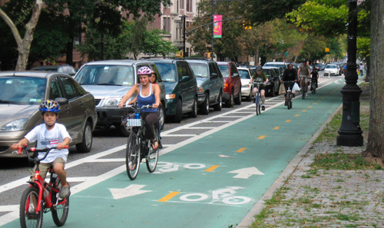
Transport & air pollution
Over half of the 40,000 air pollution deaths each year are due to the transport sector
Electric cars and active travel are the two types of solutions
Active travel: added benefits e.g. better mental health; less obesity & break & tyre wear particulates
A 5% shift in travel from cars to other modes would provide an annual benefit of 0.5% of GDP in 2030
These Photos by Unknown Authors are licensed under CC BY-SA
Solutions
New developments: public transport, walking & cycling infrastructure
Invest in & encourage public transport e.g. budget-priced inter-city rail services
Incentives for electric e.g. charging points, VAT exemptions
Sources: Carmichael 2019; Jennings 2019; UKCCC 2019; RCP London 2016
Notes:
Affected conditions include heart disease, strokes, COPD, asthma
Invite and support new budget-priced intercity rail services (such as that planned for London to Edinburgh in 2021 with £25 fares) https://www.firstgroupplc.com/about-firstgroup/uk-rail/eastcoast.aspx

Slide 6
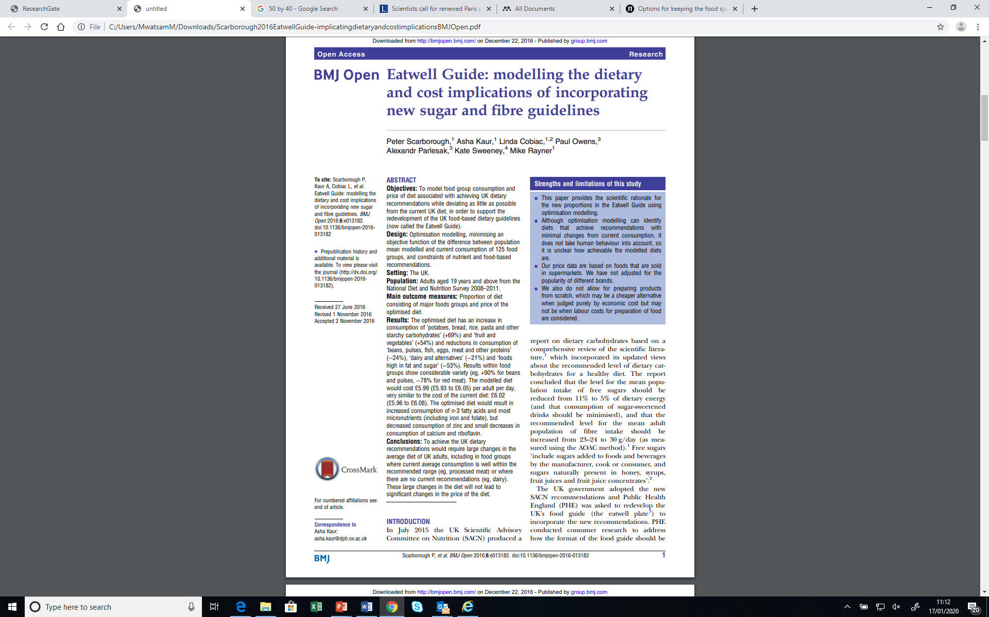
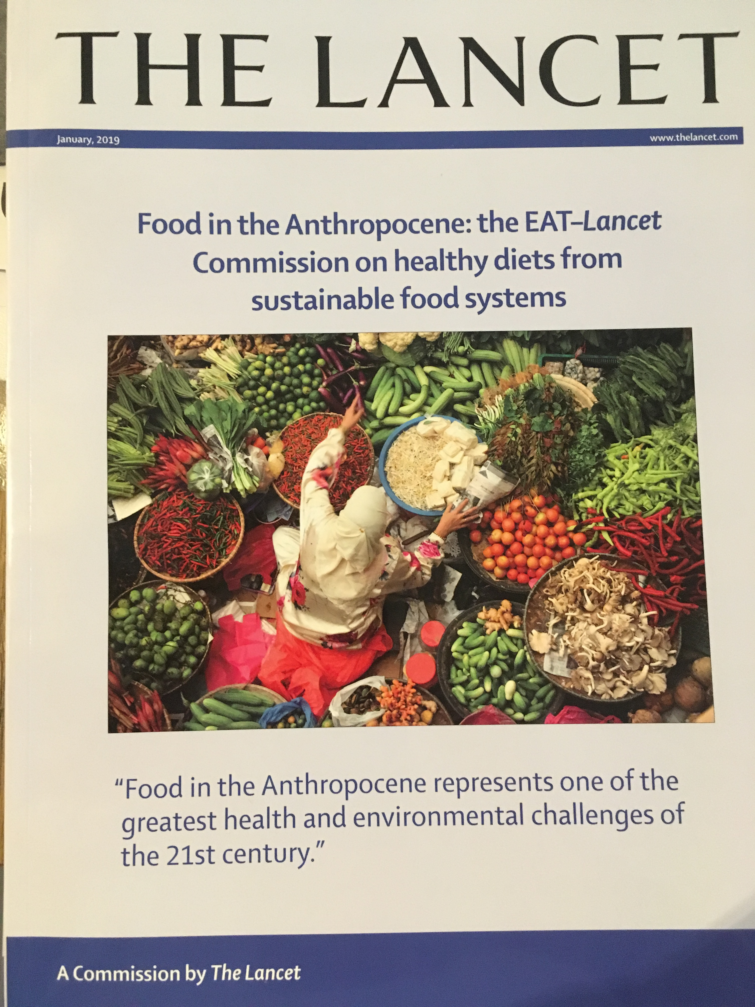
Diet & agriculture
Three quarters of EU agriculture subsidies go to livestock
Red meat & dairy have the largest GHGs of all foods
Eating excess red & processed meat is linked to a raised risk of colon cancer and heart disease
Scientific reports recommend that the UK should:
  Halve intakes of red meat & dairy
  Double intakes of pulses, whole grains, veg
This would lead to health benefits worth 0.5% of GDP by 2030; and GHG reductions of up to 75%
Sources: Carmichael 2019; Willet et al. 2019; UKCCC 2019; Scarborough et al. 2016
Notes:
UK agriculture is expected to account for approximately 30% of remaining positive emissions by 2050 under the CCC’s Further Ambition net-zero scenario (Carmichael 2019)
Halving the consumption of meat, dairy products and eggs in the EU would achieve a 25–40% reduction in greenhouse gas emissions from agriculture
Halving red meat & dairy consumption will improve people's health, reduce emissions from UK agriculture and free up land that can be used to sequester carbon via tree planting (net zero target required around 90k trees to be planted per year) and restoring peatlands and/or grow biomass.

Slide 7
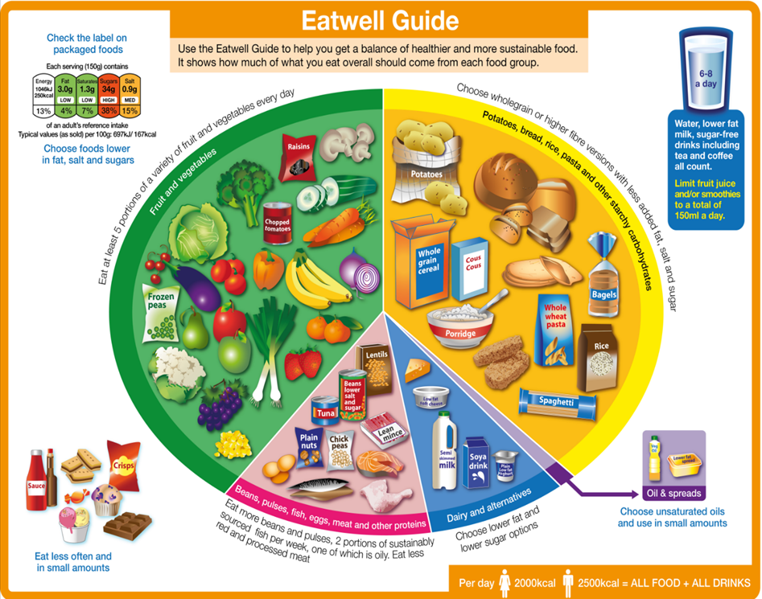
Diet & agriculture – potential solutions
Agriculture subsidies (& taxes) aligned to health & environment objectives
Procurement targets for less & better* meat & dairy; more whole grains, pulses & veg
Technological research e.g. plant based, blended and/or lab-based meat products
Mandatory environment impact labels on food e.g. Denmark
Supermarket feedback & rewards linked to the healthiness & environment impacts of purchases
*Better forms of meat & dairy have lower GHG & biodiversity impacts and better animal welfare.
Sources: Carmichael 2019; UKCCC 2019; Godfray et al. 2019
Notes:
Approximately three quarters (€29-33 billion) of the CAP direct payments go to the livestock sector
High-impact beef producers emit 12 times more GHGs and have 50 times the land use of low-emitting beef producers.
In the US new blended meat & plant burgers are on the market with 30% lower emissions

Slide 8
Thank you!

Slide 9
References / further reading
Carmichael, R. (2019) Behaviour change, public engagement and Net Zero. A report for the Committee on Climate Change. Available at https://www.theccc.org.uk/publications/ and http://www.imperial.ac.uk/icept/publications/
Godfray et al. (2018) Meat consumption, health, and the environment. https://science.sciencemag.org/content/361/6399/eaam5324
Guertler et al. (2015) The cold man of Europe. http://www.ukace.org/wp-content/uploads/2015/10/ACE-and-EBR-briefing-2015-10-Cold-man-of-Europe-update.pdf
Jennings et al. (2019) Co-benefits of climate change mitigation in the UK. https://www.imperial.ac.uk/media/imperial-college/grantham-institute/public/publications/briefing-papers/Co-benefits-of-climate-change-mitigation-in-the-UK.pdf
NICE (2015) Guideline NG6. Excess winter deaths and illness and the health risks associated with cold homes. https://www.nice.org.uk/guidance/ng6/evidence
Nicol et al. (2015) The cost of poor housing to the NHS https://www.bre.co.uk/filelibrary/pdf/87741-Cost-of-Poor-Housing-Briefing-Paper-v3.pdf
RCP London (2016) Every breath we take: the lifelong impact of air pollution. https://www.rcplondon.ac.uk/projects/outputs/every-breath-we-take-lifelong-impact-air-pollution
Scarborough et al. (2016) Eatwell Guide: modelling the dietary and cost implications of incorporating new sugar and fibre guidelines. https://bmjopen.bmj.com/content/6/12/e013182
UKCCC (2019) Net Zero The UK's contribution to stopping global warming. https://www.theccc.org.uk/publication/net-zero-the-uks-contribution-to-stopping-global-warming/
Willet et al. (2019) Food in the Anthropocene: the EAT–Lancet Commission on healthy diets from sustainable food systems. https://www.thelancet.com/commissions/EAT

